Slide 1
Utilities Interruption Tabletop Exercise
Facility-Focused Healthcare Exercise

Slide 2
Exercise Welcome
Introductions
Objectives and Takeaways
Exercise Overview
Guidelines
Timeline
Modules
Summation and Closing

Slide 3
Introductions
Hold for staff/facilitator intros as needed

Slide 4
Exercise Objectives
Assess the facility's readiness to respond to a wildfire event.
Review Emergency Operations Center (EOC) and Incident Command System (ICS) activation processes and responsibilities.
Assess preparedness for a utilities interruption event.
Identify operational gaps and critical dependencies.
Practice leadership communication and decision-making.
Evaluate continuity of care under degraded operational conditions.
Identify immediate preparedness improvements.

Slide 5
Exercise Overview and Scope
Type: Tabletop/functional
Duration: 90-150 mins
Location: In-person
Players: (fill in the blank with facility name)
Exercise Challenges and instruction given verbally

Slide 6
Exercise Guidelines
No-fault environment.
Base responses on current plans and capabilities.
Participate. This is how we learn from each other.
Keep discussion respectful and solution focused.
Capture key themes, risks, and ideas for improvement

Slide 7
Exercise Timeline
Topic | Time
Welcome and Introduction | 10 min
Module 1 | 30 min
Break | 10 min
Module 2 | 30 min
Break | 10 min
Modules 3 and 4 | 20 min
Hotwash | 20 min
Closing | 5 min
*Estimate only – timeline subject to dynamic change

Slide 8
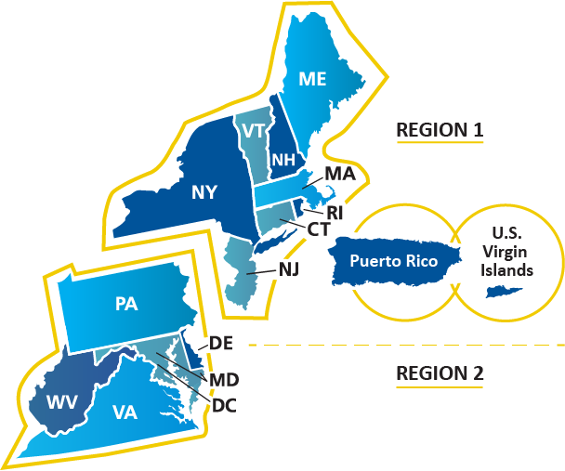
Exercise Module 1

Slide 9

Scenario Overview
A severe weather event causes widespread disruption to community infrastructure, affecting utility reliability across the region. Your facility begins experiencing cascading failures involving critical utilities, including electrical power instability, water service disruption, communications degradation, and resource strain. External vendor response times may be delayed, requiring leadership to make operational decisions to maintain safe patient/resident care under degraded conditions.

Slide 10
Module 1: Initial Utility Disruption
Commercial power begins fluctuating unexpectedly.
Systems reset intermittently, and clinical departments report equipment and information technology (IT) concerns.
Engineering is assessing generator readiness.

Slide 11
Discussion Set #1
What immediate actions should leadership take to stabilize operations and establish situational awareness?
What critical systems need immediate assessment?
Is incident command activation appropriate why or why not?

Slide 12
Scenario Update (T+6 Hours)
Commercial power fails. Emergency generators activate, but fuel sustainability may be limited. Water pressure drops, HVAC performance becomes unstable, and vendor response timelines are uncertain.

Slide 13
Discussion Set #2
What systems or care functions require immediate protection?
  Generator/fuel
  HVAC
  Vulnerable patient/resident populations
  Vendor escalation/support delays
How long can safe operations continue?
What communication should occur now?

Slide 14
Break (10 mins)

Slide 15
Exercise Module 2

Slide 16
Module 2: Operational Strain (T+10 Hours)
Water service is lost. Internal communications are intermittent. Some IT systems are degraded, and staffing coverage becomes uncertain as shift change approaches.

Slide 17
Discussion Set #1
How will leadership sustain safe operations?
What continuity of care risks are increasing?
What staffing contingency actions should occur?
Notes:
Staffing contingency plan, sanitation/infection preventions concerns, communication redundancy, service prioritization

Slide 18
Scenario Update (T+14 Hours)
The outage is expected to continue. Fuel delivery is delayed, supplies are depleting, and clinical leaders raise concerns about ongoing patient/resident care tasks.

Slide 19
Discussion Set #2
What conservation or service modification decisions are needed?
When should leadership escalate for outside support?
Are any patient transfer decisions becoming necessary?

Slide 20
Discussion Set #3
Do we have accurate numbers for:
  Fuel
  Oxygen
  Medical supplies
  Food/water

Slide 21
Break (10 mins)

Slide 22
Exercise Module 3

Slide 23
Module 3: Recovery/Restoration
Utility restoration begins, but systems remain unstable and require validation before full operations resume.
Supply replenishment and recovery planning must begin.

Slide 24
Discussion Set #1
What recovery priorities should leadership establish?
What systems require validation before full operations resume?
Who is responsible for assessing and reporting on facility damage?

Slide 25
Module 4: Recovery
Wildfire 90% contained. Air quality remains poor. Roads and utilities are still impacted but slowly coming back online.

Slide 26
Discussion Set #2
What documentation and reporting requirements exist to include conducting after-action review (AAR) and improvement planning (IP)?

Slide 27
Discussion Set #2
How will employee support needs be addressed?
How do we manage staffing fatigue?
Notes:
Think transportation to and from work, alternate housing if needed, basic ADL’s if homes impacted, etc

Slide 28
End of Exercise

Slide 29
Hotwash
What worked well? What needs improvement?

Slide 30
Key Takeaways
What stands out as items we did well and items we need to address?

Slide 31
Improvement Planning
Issue | Corrective Action | Owner | Timeline

Slide 32
Next Steps
AAR/IP development and follow-up actions.

Slide 33
Thank You
Questions and discussion.

Slide 34

Contact Us
Contact Us
Shane Durkee– Region 2, Director, Emergency Preparedness, sdurkee@ipro.org
Jessica L Picanzo – Region 1, Director, Emergency Preparedness, jpicanzo@ipro.org
Learn more about the Northeast & Mid-Atlantic QIN-QIO: https://qi.ipro.org/
This material was prepared by the Northeast and Mid-Atlantic CMS QIN-QIO (Regions 1 & 2), a Quality Innovation Network-Quality Improvement Organization, under contract with the Centers for Medicare & Medicaid Services (CMS), an agency of the U.S. Department of Health and Human Services (HHS). Views expressed in this material do not necessarily reflect the official views or policy of CMS or HHS, and any reference to a specific product or entity herein does not constitute endorsement of that product or entity by CMS or HHS. Publication # 13SOW-IPRO-R1&2-ALL-SA-A06-26-7254

