Slide 1
Harm Reduction: Making a Difference through Implementation in Practice
April 27, 2023
11am-12pm
This material was prepared by the IPRO QIN-QIO, a Quality Innovation Network-Quality Improvement Organization, under contract with the Centers for Medicare & Medicaid Services (CMS), an agency of the U.S. Department of Health and Human Services (HHS). Views expressed in this material do not necessarily reflect the official views or policy of CMS or HHS, and any reference to a specific product or entity herein does not constitute endorsement of that product or entity by CMS or HHS. Publication #12SOW-IPRO-QIN-T2-A4-23-1014
Notes:
Rebekah

Slide 2
Chat In
Please use the chat feature to share your name, organization, and state.
We want to know who is around the table
Notes:
Rebekah

Slide 3
Our Opioid Framework*
Primary
Prevention
Harm
Reduction
Evidence-Based
Treatment
Recovery
Support
*Based on the Department of Health & Human Services Overdose Prevention Strategy
https://www.hhs.gov/overdose-prevention/
Notes:
Stephanie
Based on Health & Human Services (HHS) Overdose Prevention Strategy
Primary Prevention
Prevention is critical to reducing overdoses and overdose deaths. The strategy promotes tiered, multidisciplinary prevention activities, ranging from population-level strategies to targeted interventions aimed at high-risk individuals. These activities engage health and human services providers directly and facilitate cross-sector collaboration on prevention.
This page highlights current federal activities that support prevention by expanding research of new and improved prevention efforts, investing in community resources to help prevent harms related to substance use, increasing access to high-quality pain management to reduce preventable suffering, and promoting responsible prescription of medications to protect patient safety.
Evidence-Based Treatment
Evidence-based treatments for substance use disorder can reduce substance use, related health harms (for example, infectious disease transmission), and overdose deaths. High-quality treatment can also increase social functioning. The strategy therefore focuses on reducing barriers to accessing the most effective treatments, using motivational and cultural enhancements to encourage those who might be reluctant, advancing strategies to improve engagement and retention, and continuing to develop new therapeutic approaches.
This page highlights current federal activities that advance evidence-based treatment by making treatment easy to get, delivering healthcare and support services in a seamless and coordinated way, and implementing new and improved models of care that appeal to and help those who need them.
Harm Reduction
Individuals inherently deserve services that promote health, regardless of whether they use drugs. Evidence-based harm reduction strategies minimize negative consequences of drug use. These activities further expand access to harm reduction interventions and better integrate harm reduction into general medical care.
This page highlights current federal activities that promote harm reduction by increasing the availability and access to high-quality harm reduction services, decreasing negative effects of substance use, and reducing stigma related to substance use and overdose.
Recovery Support
The strategy recognizes that treatment alone may not be enough to support long-term recovery. Despite the demonstrated benefits of recovery support services -- such as peer supports, employment and housing services -- various challenges impede their availability and uptake. Enhancing coverage and integration of recovery support services is critical to promoting access to and use of these services. Strengthening the recovery support services workforce is also essential to promoting access and quality.
This page highlights current federal activities that improve recovery support by developing different types of support throughout the lifespan, increasing the quality of services, supporting the recovery workforce, and expanding access to ongoing, affordable, and effective recovery support services.

Slide 4
Learning Objectives
Upon attending this session, participants will be able to
Define and understand the practice and key principles of harm reduction.
Implement key strategies of harm reduction in your policies and practice.
Increase knowledge of harm reduction tools and resources to better support your patients and community.

Slide 5
Variation Across New England for Opioid Overdose Deaths
Connecticut
Maine
Rhode Island
Massachusetts
New Hampshire
Vermont
https://www.cdc.gov/nchs/nvss/vsrr/drug-overdose-data.htm
Notes:
Data through March 5, 2023
According to provisional counts of reported deaths from the CDC’s National Vital Statistics System,.
Increase in overdose deaths in the US– latest report older adults

Slide 6
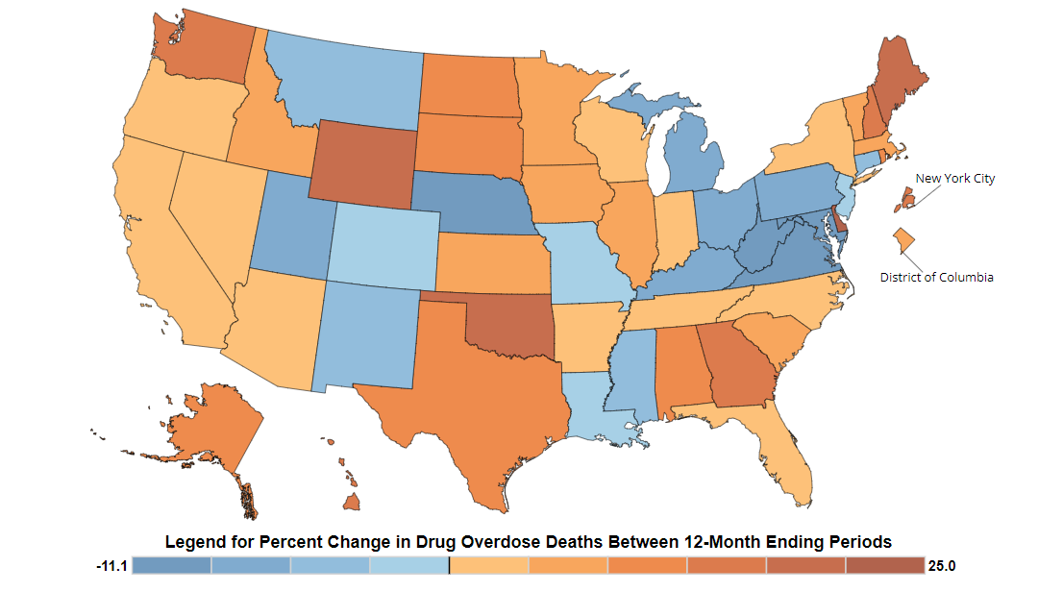
Percent Change in Deaths in the Past Year
ME 19.5%
NH 15.0%
RI 11.2%
VT 8.1%
MA 5.3%
US 1.2%
CT -5.4%
https://www.cdc.gov/nchs/nvss/vsrr/drug-overdose-data.htm
Notes:
According to provisional counts of reported deaths from the CDC’s National Vital Statistics System,.

Slide 7
Most Deaths Now Due to Synthetic Opioids
Synthetic opioid (including fentanyl) overdose deaths increased 97-fold
Psychostimulant (primarily methamphetamine) overdose deaths increased 59-fold
Cocaine overdose
deaths increased 6.4-fold
Rx opioid overdose deaths increased 4.9-fold
https://www.hhs.gov/overdose-prevention/

Slide 8
Chat In
What are your goals for this session?
We want this time to be a value add for you

Slide 9
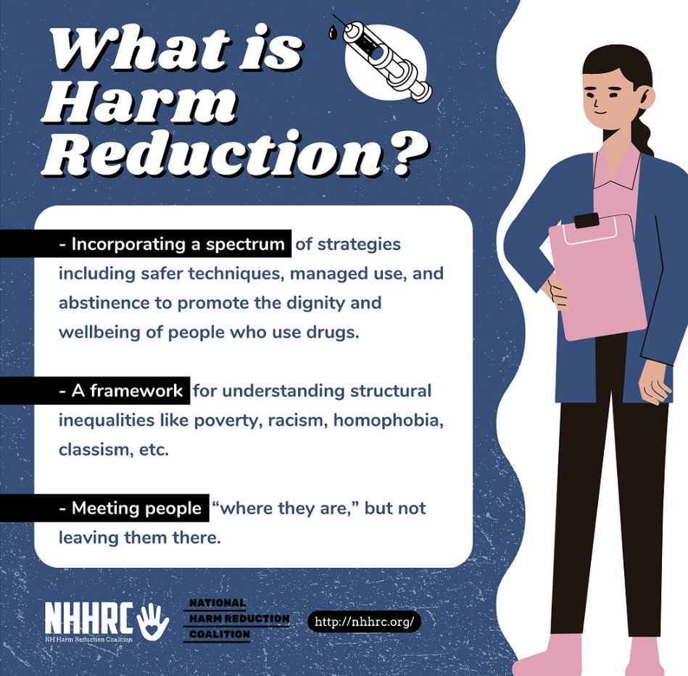
Harm Reduction
Helping people where they are, without judgment, stigma, or discrimination.

Slide 10
Harm Reduction Principles
Accepts, for better or worse, that licit and illicit drug use is part of our world and chooses to work to minimize its harmful effects rather than simply ignore or condemn them
Understands drug use as a complex, multi-faceted phenomenon that encompasses a continuum of behaviors from severe use to total abstinence, and acknowledges that some ways of using drugs are clearly safer than others
Establishes quality of individual and community life and well-being — not necessarily cessation of all drug use — as the criteria for successful interventions and policies
Source: National Harm Reduction Coalition, 2020
https://harmreduction.org/wp-content/uploads/2022/12/NHRC-PDF-Principles_Of_Harm_Reduction.pdf
Notes:
Harm reduction is a set of practical strategies and ideas aimed at reducing negative consequences associated with drug use. Harm Reduction is also a movement for social justice built on a belief in, and respect for, the rights of people who use drugs.

Slide 11
Harm Reduction Principles, continued
Ensures that people who use drugs and those with a history of drug use routinely have a real voice in the creation of programs and policies designed to serve them
Affirms people who use drugs (PWUD) themselves as the primary agents of reducing harms of their drug use and seeks to empower PWUD to share information and support each other in strategies which meet their actual conditions of use
Does not attempt to minimize or ignore the real and tragic harm and danger that can be associated with illicit drug use
Calls for the non-judgmental, non-coercive provision of services and resources to people who use drugs and the communities in which they live in order to assist them in reducing attendant harm
Source: National Harm Reduction Coalition, 2020
https://harmreduction.org/wp-content/uploads/2022/12/NHRC-PDF-Principles_Of_Harm_Reduction.pdf
Notes:
Harm reduction is a set of practical strategies and ideas aimed at reducing negative consequences associated with drug use. Harm Reduction is also a movement for social justice built on a belief in, and respect for, the rights of people who use drugs.

Slide 12
Evidence-based Harm Reduction Services
Naloxone distribution
Syringe Services Programs
Fentanyl Testing
Mobile Crisis Interventions

Slide 13
Panel Discussion
Theresa Vezine
Executive Director
Vermont Cares
Sarah DeJesus
Program Manager
Berkshire Harm Reduction Program
Phoebe Axtman
Director of Education
NH Harm Reduction
Notes:
Theresa Vezina is the Executive Director at Vermont CARES where she has spent more than a decade working in HIV Care and Harm Reduction services. She is a recognized leader in our state facilitating harm reduction and overdose prevention trainings around the state to a wide range of audiences. She is deeply connected to harm reduction through the provision of direct services, and the many coalitions where she does advocacy work for the rights of people who use drugs. Prior to her work with Vermont CARES Theresa was in private practice for 10 years, where she offered holistic healing work through a variety of modalities. This is where her journey began offering people safe space, unconditional love, and compassion.
Sarah is an accomplished professional in the Harm Reduction industry and is committed to developing services that improve every community she works in. Her 17+ years in the Harm Reduction arena allows her to bring a value to the individuals she works with, not easily matched by others. Her positive, creative, non-biased approach to relationship building allows both colleagues and clients to feel encompassed in a circle of empathy, respect, and professionalism. Regardless of the environment, Sarah always has the safety and wellness of everyone she interacts with as her priority.

Slide 14
Vermont Cares
Vermont CARES provides life-saving harm reduction services, education and resources to Vermonters affected by HIV, Hepatitis C and substance use by increasing access to care, reducing social stigmas and building relationships.

Slide 15
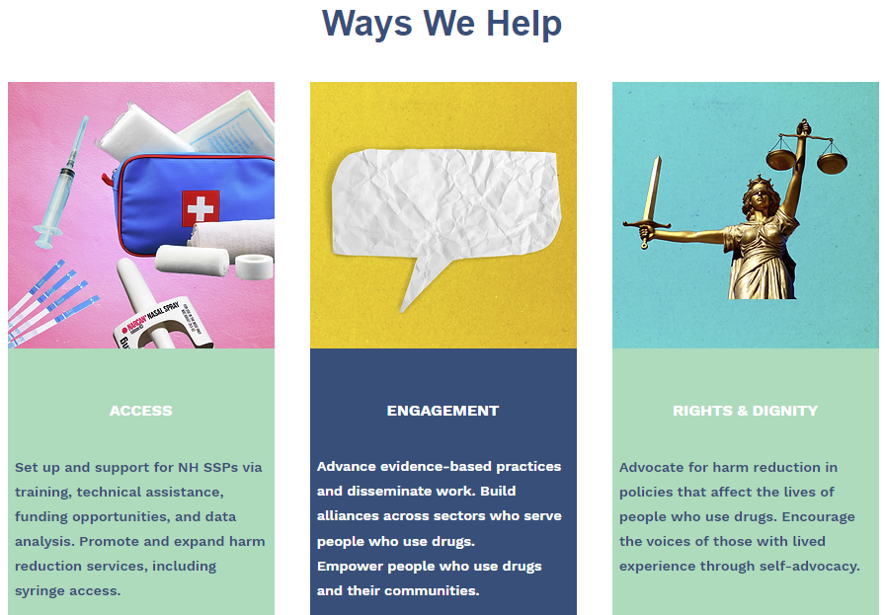
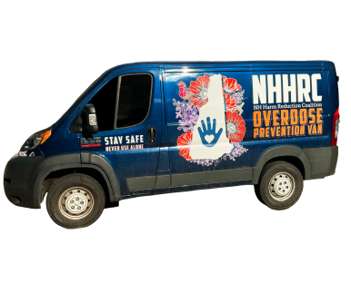
New Hampshire Harm Reduction
NHHRC is a statewide grassroots organization dedicated to the implementation of public health strategies that reduce the harm associated with drug use and misuse. NHHRC engages in policy advocacy, multi-sector education, resource and policy development, coalition and capacity building, and direct services.

Slide 16
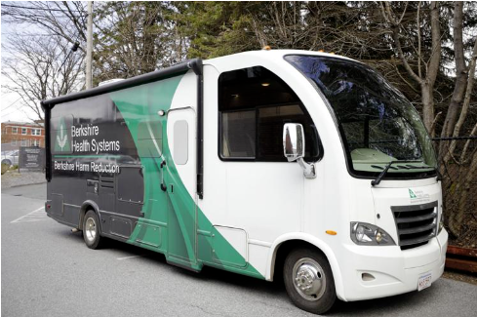
Berkshire Health Harm Reduction
Supported by the Massachusetts Department of Public Health, the Berkshire Harm Reduction Program at Berkshire Medical Center provides several vital services to the community. Services are provided at three convenient locations in the Berkshires and through our Harm Reduction Mobile Unit, which travels to locations throughout the region.

Slide 17
Chat In
How are you working with Harm Reduction partners in your community?
Or
What would be helpful for you to build connections with Harm Reduction services, for your patients?
Notes:
Marghie-

Slide 18
Panel Discussion
Theresa Vezine
Executive Director
Vermont Cares
Sarah DeJesus
Program Manager
Berkshire Harm Reduction Program
Phoebe Axtman
Director of Education
NH Harm Reduction
Notes:
Theresa Vezina is the Executive Director at Vermont CARES where she has spent more than a decade working in HIV Care and Harm Reduction services. She is a recognized leader in our state facilitating harm reduction and overdose prevention trainings around the state to a wide range of audiences. She is deeply connected to harm reduction through the provision of direct services, and the many coalitions where she does advocacy work for the rights of people who use drugs.
Prior to her work with Vermont CARES Theresa was in private practice for 10 years, where she offered holistic healing work through a variety of modalities. This is where her journey began offering people safe space, unconditional love, and compassion.
Sarah is an accomplished professional in the Harm Reduction industry and is committed to developing services that improve every community she works in. Her 17+ years in the Harm Reduction arena allows her to bring a value to the individuals she works with, not easily matched by others. Her positive, creative, non-biased approach to relationship building allows both colleagues and clients to feel encompassed in a circle of empathy, respect, and professionalism. Regardless of the environment, Sarah always has the safety and wellness of everyone she interacts with as her priority.

Slide 19
Panel Questions
What if the patient isn’t ready for treatment or they aren’t ready for medications? How do you reduce harm?
How do you partner with healthcare providers such as hospitals, primary care, nursing homes, home health, community health centers, community resources, etc.
If there was one thing that you wanted to get the word out about harm reduction, what would that be?

Slide 20
Harm Reduction in your State
CT- Connecticut Harm Reduction https://www.ghhrc.org/
MA- RIZE https://www.rizema.org/
ME- Maine Access Points https://www.maineaccesspoints.org/harmreduction
NH- New Hampshire Harm Reduction Coalition https://www.nhhrc.org/
RI- Harm Reduction Centers https://health.ri.gov/addiction/about/harmreductioncenters/
VT- Vermont Cares https://vtcares.org/

Slide 21
Harm Reduction Learning Circle
May 11th 11-11:30am
Want to delve a little deeper into the topic of Harm Reduction? This learning circle is a great opportunity to hear what others are doing around implementation. You’re invited to informally share on challenges, successes, and ask questions in an open forum..
https://healthcentricadvisors.zoom.us/meeting/register/tZUldOyurTkjGtOm8R1srI7eR3HM3eRccJjf#/registration

Slide 22
Reserve Your Seat for the Full Series
5/18 11am-12pm: Universal Precautions in Pain Management: A Person-Centered Approach to Preventing Opioid Misuse
6/1 11am-11:30am: Prevention Learning Circle
5/25 11am-12pm: Opioid Use Disorder: Paving the Way for Evidence Base Care across the Continuum
6/11 11-11:30am: Treatment Learning Circle
6/22 11am-12pm: Supporting the Recovery Journey with Community Connections
7/13 11-11:30am: Recovery Learning Circle
7/27 11am-12pm: Bringing it All Together

