Slide 1
2022-2023 Influenza Season: What’s new? Who’s involved? And Why?
Nina Bagtas
PharmD 2023 Candidate
Binghamton School of Pharmacy and Pharmaceutical Sciences
IPRO Presentation – 12/13/22
This material was prepared by IPRO, a Quality Innovation Network-Quality Improvement Organization under contract with the Centers for Medicare & Medicaid Services (CMS), an agency of the U.S. Department of Health and Human Services. The content presented does not necessarily reflect CMS policy. Publication 12SOW-IPRO-QIN-TA-A5-22-843

Slide 2
Objectives
To analyze 2021-2022 influenza season epidemiology and composition and its effects on the 2022-2023 influenza season.
To examine new CDC recommendations for influenza vaccine for people 65 years and older.
To compare the different influenza vaccinations recommended for that population in terms of dose, type of vaccine, administration, contraindications, adverse effects, and cost.
To understand recommendations of coadministration of the influenza vaccine with COVID-19, pneumococcal, and Zoster vaccinations.

Slide 3
Vaccine Abbreviations
Influenza Vaccine Types
IIV | Inactivated Influenza Vaccine (≥ 6 months)
RIV | Recombinant Influenza Vaccine (≥ 18 years)
LAIV | Live-attenuated Influenza Vaccine (2-49 years)
Numerals to Indicate Valency (number of influenza viruses represented)
4 | quadrivalent
3 | trivalent
Prefixes that refer to certain Inactivated Influenza Vaccines
a | adjuvanted (aIIV4)
HD | high dose (HD-IIV4)
cc | cell-culture based (ccIIV4)
Summary of recommendations [Internet]. Centers for Disease Control and Prevention. Centers for Disease Control and Prevention; 2022 [cited 2022Oct5]. Available from: https://www.cdc.gov/flu/professionals/acip/summary/summary-recommendations.htm#65years

Slide 4
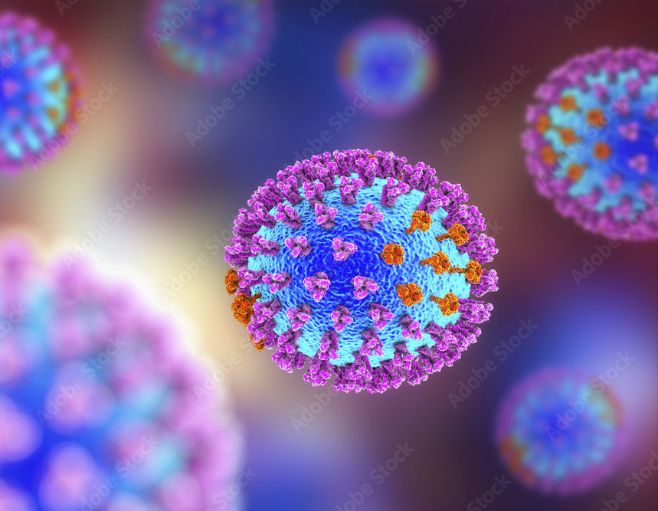
Background - Influenza
Single-stranded RNA virus of the orthomyxovirus family
Three types known to affect humans: A, B and C
Influenza A subtypes are based on surface antigens hemagglutinin (HA) and neuraminidase (NA)
18 different H subtypes and 11 different N subtypes
Influenza B classified into lineages: B/Yamagata and B/Victoria
Antigenic changes: viral surface antigen HA and NA undergo small mutations, accumulating over time that results in changes that the immune system may not recognize
Pinkbook: Influenza [Internet]. Centers for Disease Control and Prevention. Centers for Disease Control and Prevention; 2021 [cited 2022Oct5]. Available from: https://www.cdc.gov/vaccines/pubs/pinkbook/flu.html#:~:text=People%20most%20at%20risk%20of,younger%20than%20age%202%20years.

Slide 5
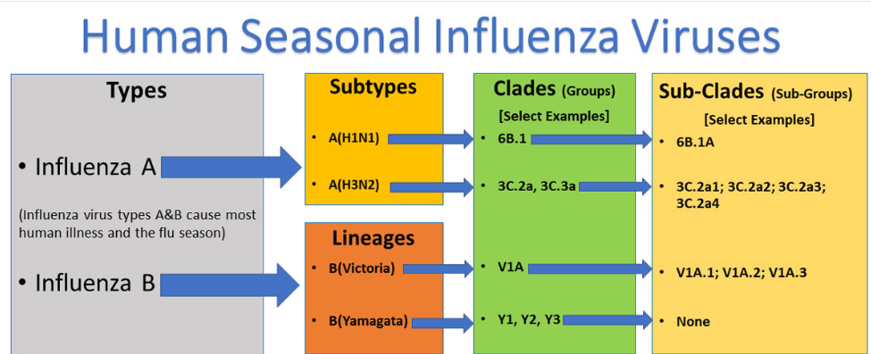
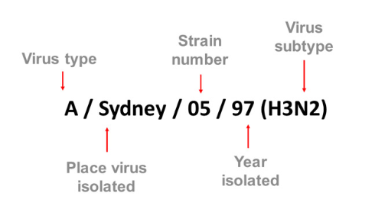
Background Cont.
Pinkbook: Influenza [Internet]. Centers for Disease Control and Prevention. Centers for Disease Control and Prevention; 2021 [cited 2022Oct5]. Available from: https://www.cdc.gov/vaccines/pubs/pinkbook/flu.html#:~:text=People%20most%20at%20risk%20of,younger%20than%20age%202%20years.

Slide 6
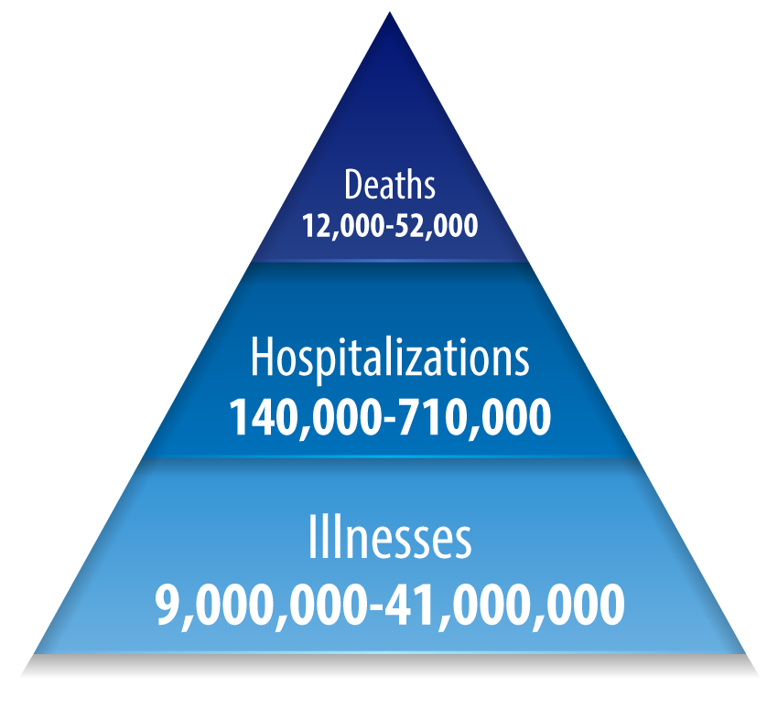
Influenza Epidemiology
CDC estimates that between 2010 - 2020, the flu has led to 9 million - 41 million illnesses, 140,000-710,000 hospitalizations and 12,000-52,000 deaths.
Overall CDC estimated that adults 65 years and older account for 70-85% of flu-related deaths and 50-70% of flu-related hospitalizations each season.
Disease burden of flu [Internet]. Centers for Disease Control and Prevention. Centers for Disease Control and Prevention; 2022 [cited 2022Oct6]. Available from: https://www.cdc.gov/flu/about/burden/index.html

Slide 7
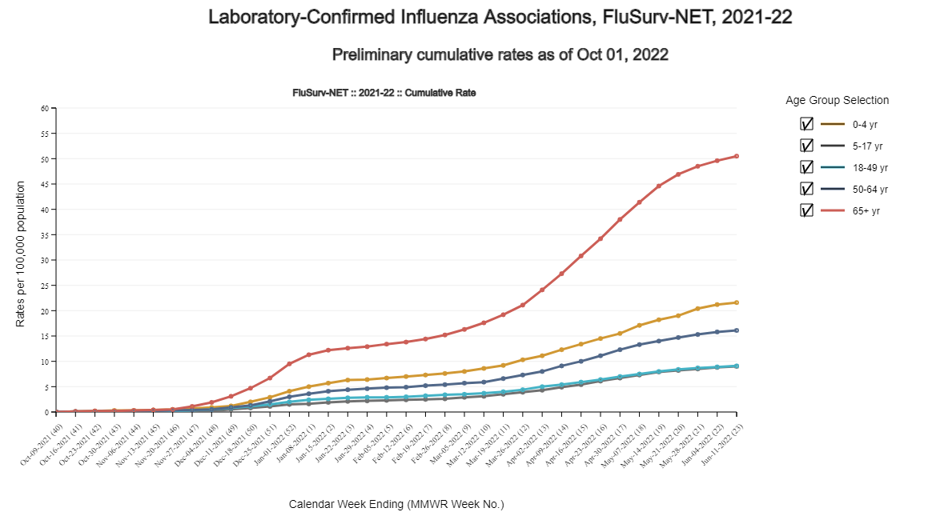
Influenza Epidemiology: 2021-2022 Season
The 2021-2022 season incurred 9 million flu illnesses, 4 million flu medical visits, 100,000 flu hospitalizations and 5,000 flu deaths.
The 2021-2022 season was described overall as low severity by the CDC, but the effect and severity of influenza differed by age group with adults ≥ 65 years as higher severity.
Preliminary estimated influenza illnesses, medical visits, hospitalizations, and deaths in the United States - 2021-2022 influenza season [Internet]. Centers for Disease Control and Prevention. Centers for Disease Control and Prevention; 2022 [cited 2022Oct8]. Available from: https://www.cdc.gov/flu/about/burden/2021-2022.htm

Slide 8
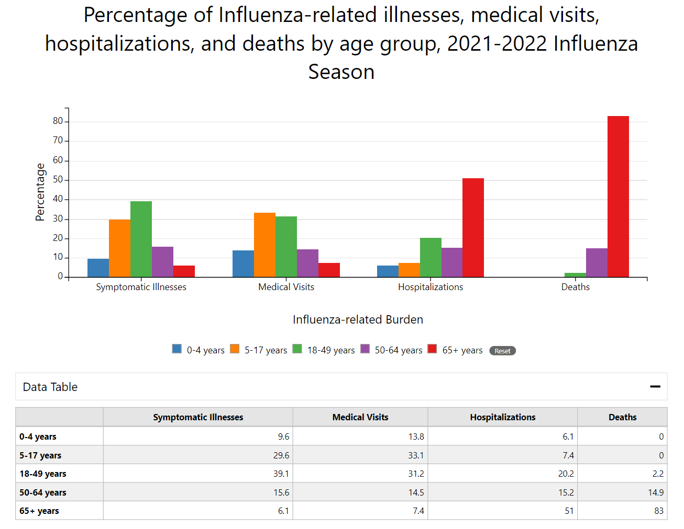
Influenza Epidemiology: 2021-2022 Season
For the 2021-2022 influenza season, CDC estimates that people 65 years and older account for 83% of flu-related deaths and 51% of flu-related hospitalizations in the United States.
Preliminary estimated influenza illnesses, medical visits, hospitalizations, and deaths in the United States - 2021-2022 influenza season [Internet]. Centers for Disease Control and Prevention. Centers for Disease Control and Prevention; 2022 [cited 2022Oct8]. Available from: https://www.cdc.gov/flu/about/burden/2021-2022.htm

Slide 9
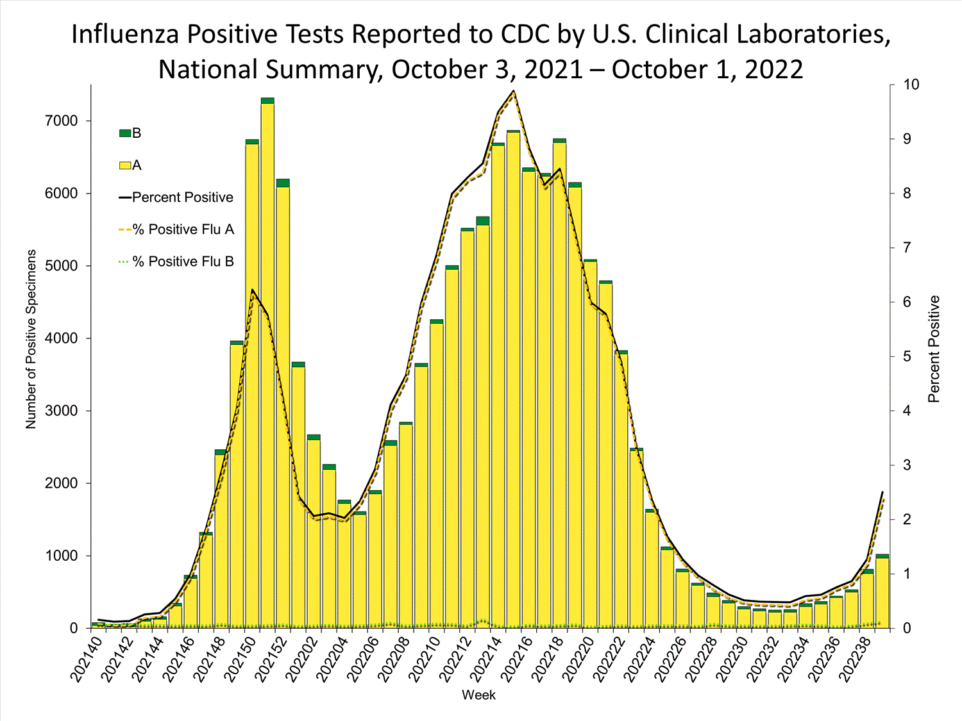
2021-2022 Influenza Season
When compared to influenza seasons prior, the 2021-2022 influenza season was mild and had two waves.
Influenza A(H3N2) dominated the 2021-2022 influenza season during both waves.
Those vaccinated during the 2021-2022 influenza season reduced their risk of illness by approximately one-third.
Influenza activity and composition of the 2022–23 influenza vaccine - United States, 2021–22 season [Internet]. Centers for Disease Control and Prevention. Centers for Disease Control and Prevention; 2022 [cited 2022Oct8]. Available from: https://www.cdc.gov/mmwr/volumes/71/wr/mm7129a1.htm

Slide 10
Composition of 2022-2023 Influenza Vaccine
FDA Vaccines and Related Biological Products Advisory Committee (VRBPAC) selected influenza virus strains for the 2022-2023 influenza season.
For quadrivalent, egg-based influenza vaccines:
A/Victoria/2570/2019 (H1N1)pdm09-like virus
A/Darwin/9/2021 (H3N2)-like virus
B/Austria/1359417/2021-like virus (B/Victoria lineage)
B/Phuket/3073/2013-like virus (B/Yamagata lineage)
For quadrivalent formulation of cell or recombinant based influenza vaccines:
A/Wisconsin/588/2019 (H1N1)pdm09-like virus
A/Darwin/6/2021 (H3N2)-like virus
B/Austria/1359417/2021-like virus (B/Victoria lineage)
B/Phuket/3073/2013-like virus (B/Yamagata lineage)
No changes were made to the A(H1N1)pdm09 or the B/Yamagata egg-based, cell-based, or recombinant vaccine recommended components from the 2021/2022 season.
Center for Biologics Evaluation and Research. Influenza vaccine for the 2022-2023 season [Internet]. U.S. Food and Drug Administration. FDA; 2022 [cited 2022Oct8]. Available from: https://www.fda.gov/vaccines-blood-biologics/lot-release/influenza-vaccine-2022-2023-season

Slide 11
Symptoms of Influenza and COVID-19
Influenza Symptoms
COVID-19 Symptoms
Fever or chills
Cough
Sore throat
Runny or stuffy nose
Muscle or body aches
Fatigue
Vomiting
Diarrhea
Fever or chills
Cough
Sore throat
Runny or stuffy nose
Muscle or body aches
SOB or difficulty breathing
Fatigue
Headache
Loss of smell and/or taste
Nausea/Vomiting
Diarrhea
Similarities and differences between flu and covid-19​ [Internet]. Centers for Disease Control and Prevention. Centers for Disease Control and Prevention; 2022 [cited 2022Oct8]. Available from: https://www.cdc.gov/flu/symptoms/flu-vs-covid19.htm

Slide 12
Who is most at-risk for complications?
Children younger than 5 years, especially children younger than 2 years of age
Adults aged 65 years and older
People with chronic medical conditions (such as asthma, COPD, heart disease or diabetes)
People with a weakened immune system due to disease (HIV or cancer) or due to medications (long-term corticosteroid, immune-system suppressing drugs, radiation, or chemotherapy)
Pregnant women and postpartum women up to 2 weeks after delivery
People who live in nursing homes or other long-term care facilities
People from certain racial or ethnic minority groups at increased risk for hospitalizations including non-Hispanic blacks, Hispanic or Latinos, and American Indian/Alaskan natives
People at higher risk of flu complications [Internet]. Centers for Disease Control and Prevention. Centers for Disease Control and Prevention; 2022 [cited 2022Oct5]. Available from: https://www.cdc.gov/flu/highrisk/index.htm

Slide 13
CDC Recommendations for People 65 years and Older
Advisory Committee on Immunization Practices (ACIP) recommends that adults aged 65 and older receive one of the following influenza vaccines:
Quadrivalent high dose inactivated influenza vaccine (HD-IIV4)
Quadrivalent recombinant influenza vaccine (RIV4)
Quadrivalent adjuvanted inactivated influenza vaccine (aIIV4)
Summary of recommendations [Internet]. Centers for Disease Control and Prevention. Centers for Disease Control and Prevention; 2022 [cited 2022Oct5]. Available from: https://www.cdc.gov/flu/professionals/acip/summary/summary-recommendations.htm#65years

Slide 14
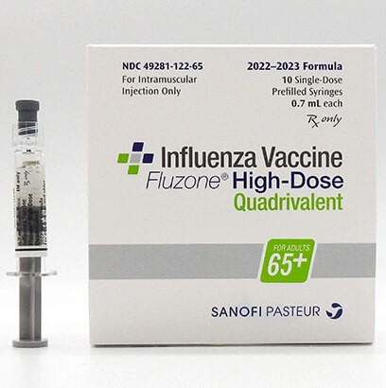
HD-IIV4
Fluzone High-Dose Quadrivalent
0.7mL dose for intramuscular injection
Approved for use in people ≥ 65 years
Contains four times the antigen than other standard dose vaccines to create a stronger immune response
Contains 60 micrograms (mcg) hemagglutinin (HA) per strain compared to 15 mcg HA standard dose vaccine
Fluzone high-dose quadrivalent (influenza vaccine) for 65 and older [Internet]. Fluzone High-Dose Quadrivalent (Influenza Vaccine) for 65 and Older | Sanofiflu.com. [cited 2022Oct8]. Available from: https://www.sanofiflu.com/fluzone-high-dose-influenza-vaccine/

Slide 15
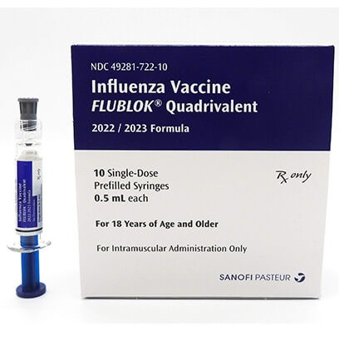
RIV4
Flublok Quadrivalent
0.5mL dose for intramuscular injection
Approved for use in people ≥ 18 years
Provided 30% better protection in adults ≥ 50 compared to standard dose quadrivalent vaccine
A completely egg-free vaccination made using recombinant technology
Contains three times more antigen than standard-dose influenza vaccine
Flublok quadrivalent (influenza vaccine) for adults 18+ [Internet]. Flublok Quadrivalent (Influenza Vaccine) for Adults 18+ | Sanofiflu.com. [cited 2022Oct10]. Available from: https://www.sanofiflu.com/flublok-quadrivalent-influenza-vaccine/

Slide 16
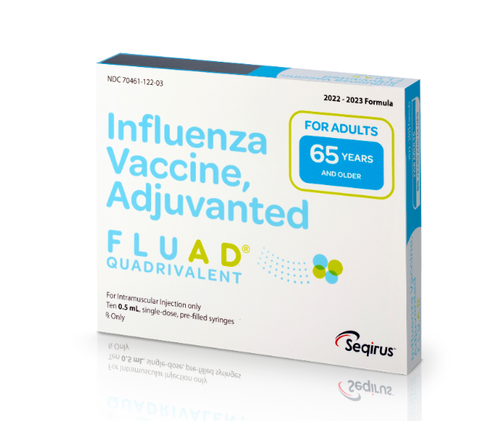
aIIV4
Fluad Quadrivalent
0.5mL dose for intramuscular injection
Approved for use in people ≥ 65 years
Contains an adjuvant, MF59 which is an oil-in-water emulsion of squalene oil, that promotes a stronger immune response
Choose an adjuvanted vaccine to help prevent seasonal influenza [Internet]. FLUAD® QUADRIVALENT | CSL Seqirus flu360. [cited 2022Oct10]. Available from: https://www.flu360.com/products/fluad?seasonCategoryCode=Seqirus_InSeason

Slide 17
Side-by-Side Comparison
Vaccine type | Trade Name | Presentation | Age indication | μg of hemagglutinin (HA) | Route of Administration | Egg based?
HD-IIV4 | Fluzone High-Dose Quadrivalent (Sanofi Pasteur) | 0.7mL PFS | ≥ 65 years | 60μg/0.7mL | IM | Yes
RIV4 | Flublok Quadrivalent (Sanofi Pasteur) | 0.5mL PFS | ≥ 18 years | 45μg/0.5mL | IM | No
aIIV4 | Fluad Quadrivalent (Seqirus) | 0.5mL PFS | ≥ 65 years | 15μg/0.5mL | IM | Yes
HA = hemagglutinin, a major protein of influenza virus
PFS = Prefilled syringe
Table. influenza vaccines - united states, 2021–22 influenza season* [Internet]. Centers for Disease Control and Prevention. Centers for Disease Control and Prevention; 2021 [cited 2022Oct10]. Available from: https://www.cdc.gov/flu/professionals/acip/2021-2022/acip-table.htm

Slide 18
Contraindications and Precautions
Contraindication:
History of severe allergic reaction (anaphylaxis) to any component of the vaccine or to a previous dose of any influenza vaccine (other than egg)
Precautions:
Moderate or severe acute illness with or without fever
History of Guillain-Barre Syndrome within 6 weeks of receiving influenza vaccine
Note on egg allergies: Persons with egg allergies may receive any licensed recommended influenza vaccine appropriate for age and health status. Persons reporting symptoms other than hives (such as angioedema, respiratory distress, lightheadedness, or recurrent emesis) or who required epinephrine may also receive any licensed recommended influenza vaccine. If a vaccine other than RIV4 or ccIIV4 is given, it must be given in an inpatient or outpatient medical center supervised by a health care provider who can recognize and manage severe allergic reactions.
Summary of recommendations [Internet]. Centers for Disease Control and Prevention. Centers for Disease Control and Prevention; 2022 [cited 2022Oct10]. Available from: https://www.cdc.gov/flu/professionals/acip/summary/summary-recommendations.htm#65years

Slide 19
Adverse Drug Events (ADE)
Adverse drug events occurring within 1 week of vaccination in adults ≥ 65 years old
Fluzone High-Dose Quadrivalent¹ | Flublok Quadrivalent*² | Fluad Quadrivalent³
Injection-site pain (35.6%), myalgia (21.4%), injection-site erythema (14.9%), malaise (18%), headache (16.8%), injection-site swelling (8.9%), fever ≥ 99.5°F (3.6%) | Injection site tenderness (34%), injection-site pain (19%), headache (13%), fatigue (12%), myalgia (9%), arthralgia (8%), nausea (5%), chills (5%), injection-site swelling (3%), injection-site erythema (3%), fever ≥ 100.4°F (<1%) | Injection-site pain (16.3%), headache (10.8%), fatigue (10.5%), myalgia (7.7%), arthralgia (7.3), chills (5.0%), diarrhea (4.1%), nausea (3.8%), loss of appetite (3.6%), fever ≥ 100.4°F (1.7%)
*ADE in adults ≥ 50 years old
Post-marketing Experiences:
Thrombocytopenia, lymphadenopathy, allergic reactions (anaphylaxis, angioedema), Extensive swelling lasting >7 days, muscular weakness, encephalomyelitis, Guillain-Barré Syndrome (GBS), convulsions, myelitis, facial palsy (Bell’s Palsy), neuritis, neuralgia, syncope, paresthesia, generalized skin reactions, SJS, vasculitis, dyspnea, rhinitis, cough, wheezing, throat tightness
Center for Biologics Evaluation and Research. Fluzone quadrivalent, fluzone high-dose quadrivalent [Internet]. U.S. Food and Drug Administration. FDA; [cited 2022Oct10]. Available from: https://www.fda.gov/vaccines-blood-biologics/vaccines/fluzone-quadrivalent-fluzone-high-dose-quadrivalent-fluzone-intradermal-quadrivalent-fluzone
Center for Biologics Evaluation and Research. Flublok quadrivalent [Internet]. U.S. Food and Drug Administration. FDA; [cited 2022Oct11]. Available from: https://www.fda.gov/vaccines-blood-biologics/vaccines/flublok-quadrivalent
Center for Biologics Evaluation and Research. Fluad quadrivalent [Internet]. U.S. Food and Drug Administration. FDA; [cited 2022Oct11]. Available from: https://www.fda.gov/vaccines-blood-biologics/fluad-quadrivalent

Slide 20
Cost Comparison
Vaccine | Cost
Fluzone High-Dose Quadrivalent | $67-$80
Flublok Quadrivalent | $74-$91
Fluad Quadrivalent | $67-$78
Prescription prices, Coupons & pharmacy information [Internet]. GoodRx. [cited 2022Nov21]. Available from: https://www.goodrx.com/

Slide 21
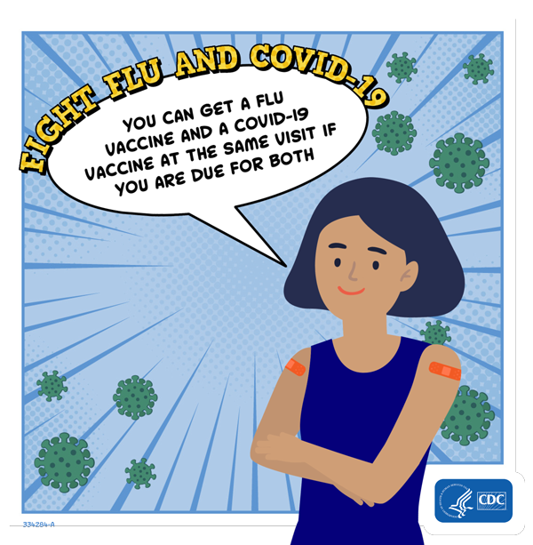
Coadministration with COVID-19
COVID-19 vaccines may be administered without regard to other vaccines, and this includes simultaneous administration of COVID-19 and influenza vaccines.
Studies comparing separate administration with coadministration of both vaccines reported similar levels of immunogenicity or slightly higher reactogenicity.
No safety concerns were identified.
8-11% likely to experience systemic reactions when coadministration is done
Clinical guidance for covid-19 vaccination [Internet]. Centers for Disease Control and Prevention. Centers for Disease Control and Prevention; 2022 [cited 2022Oct12]. Available from: https://www.cdc.gov/vaccines/covid-19/clinical-considerations/interim-considerations-us.html#timing-spacing-interchangeability
Hause AM, Zhang B, Yue X, et al. Reactogenicity of Simultaneous COVID-19 mRNA Booster and Influenza Vaccination in the US. JAMA Netw Open. 2022;5(7):e2222241. doi:10.1001/jamanetworkopen.2022.22241
Photo Source: https://www.cdc.gov/flu/prevent/coadministration.htm

Slide 22
Coadministration with Other Vaccines
Pneumococcal (PCV13, PCV15, PCV20, PPSV23)¹
For those who have never received pneumococcal vaccination, CDC recommends PCV15 or PCV20 for those 65 years and older. PCV15 should be followed by a dose of PPSV23 at least one year later.
Any pneumococcal vaccination (PCV13, PCV15, PCV20, PPSV23) can be administered concomitantly, at different anatomical sites as the influenza vaccine.
Shingrix (Recombinant Zoster Vaccine - RZV)²
CDC recommends two doses of Shingrix separated by 2-6 months for adults aged 50 years and older.
Shingrix can be administered concomitantly, at different anatomical sites with other vaccinations, including influenza.
Coadministration of Shingrix with adjuvanted influenza vaccine (Fluad) and COVID-19 vaccinations are still being studied.
Pneumococcal vaccination: For Providers [Internet]. Centers for Disease Control and Prevention. Centers for Disease Control and Prevention; 2022 [cited 2022Oct17]. Available from: https://www.cdc.gov/vaccines/vpd/pneumo/hcp/index.html
Herpes zoster Shingrix vaccine recommendations [Internet]. Centers for Disease Control and Prevention. Centers for Disease Control and Prevention; 2022 [cited 2022Oct17]. Available from: https://www.cdc.gov/vaccines/vpd/shingles/hcp/shingrix/recommendations.html

Slide 23
FDA Approved Antiviral Drugs Recommended by CDC to Treat Influenza
Generic | Trade Name | Dose | Indication | Dosage form | SIG | Other info
Oseltamivir phosphate | Tamiflu | 30mg, 45mg, 75mg, 6mg/mL | Early influenza tx in people ≥ 14 days Influenza Ppx in people ≥ 1 year | Capsule, liquid suspension | Tx: 75mg BID x 5 days Ppx: 75mg QD x 10 days | Efficacy not established after 48 hours of sx.
Zanamivir | Relenza | 5mg | Early tx of flu in people ≥ 7 years Influenza Ppx in people ≥ 5 years | Inhalation | Tx: 10mg BID x 5 days Ppx: 10mg QD x 10-28 days | NOT recommended for people with COPD or asthma. NOT proven effective for Ppx in nursing home residents.
Peramivir | Rapivab | 600mg | Early tx of acute uncomplicated influenza who have been symptomatic for ≤ 2 days | IV | Once for minimum 15 mins | Efficacy not established for serious influenza requiring hospitalization.
Baloxavir marboxil | Xofluza | 20mg, 40mg | Early tx of acute uncomplicated influenza in people ≥ 12 yrs | Tablet | 40-80kg: two 20mg QD ≥ 80kg: two 40mg QD | Avoid coadministration with dairy products, polyvalent cation containing antacids or laxatives
Administer approved antiviral treatments within 48 hours of symptom onset.
What you should know about flu antiviral drugs [Internet]. Centers for Disease Control and Prevention. Centers for Disease Control and Prevention; 2022 [cited 2022Oct18]. Available from: https://www.cdc.gov/flu/treatment
Prescription prices, Coupons & pharmacy information [Internet]. GoodRx. [cited 2022Nov30]. Available from: https://www.goodrx.com/

Slide 24
Questions?

Slide 25
References
Summary of recommendations [Internet]. Centers for Disease Control and Prevention. Centers for Disease Control and Prevention; 2022 [cited 2022Oct5]. Available from: https://www.cdc.gov/flu/professionals/acip/summary/summary-recommendations.htm#65years
Pinkbook: Influenza [Internet]. Centers for Disease Control and Prevention. Centers for Disease Control and Prevention; 2021 [cited 2022Oct5]. Available from: https://www.cdc.gov/vaccines/pubs/pinkbook/flu.html#:~:text=People%20most%20at%20risk%20of,younger%20than%20age%202%20years.
Disease burden of flu [Internet]. Centers for Disease Control and Prevention. Centers for Disease Control and Prevention; 2022 [cited 2022Oct6]. Available from: https://www.cdc.gov/flu/about/burden/index.html
Preliminary estimated influenza illnesses, medical visits, hospitalizations, and deaths in the United States - 2021-2022 influenza season [Internet]. Centers for Disease Control and Prevention. Centers for Disease Control and Prevention; 2022 [cited 2022Oct8]. Available from: https://www.cdc.gov/flu/about/burden/2021-2022.htm
Influenza activity and composition of the 2022–23 influenza vaccine - United States, 2021–22 season [Internet]. Centers for Disease Control and Prevention. Centers for Disease Control and Prevention; 2022 [cited 2022Oct8]. Available from: https://www.cdc.gov/mmwr/volumes/71/wr/mm7129a1.htm
Center for Biologics Evaluation and Research. Influenza vaccine for the 2022-2023 season [Internet]. U.S. Food and Drug Administration. FDA; 2022 [cited 2022Oct8]. Available from: https://www.fda.gov/vaccines-blood-biologics/lot-release/influenza-vaccine-2022-2023-season
Similarities and differences between flu and covid-19​ [Internet]. Centers for Disease Control and Prevention. Centers for Disease Control and Prevention; 2022 [cited 2022Oct8]. Available from: https://www.cdc.gov/flu/symptoms/flu-vs-covid19.htm
People at higher risk of flu complications [Internet]. Centers for Disease Control and Prevention. Centers for Disease Control and Prevention; 2022 [cited 2022Oct5]. Available from: https://www.cdc.gov/flu/highrisk/index.htm
Fluzone high-dose quadrivalent (influenza vaccine) for 65 and older [Internet]. Fluzone High-Dose Quadrivalent (Influenza Vaccine) for 65 and Older | Sanofiflu.com. [cited 2022Oct8]. Available from: https://www.sanofiflu.com/fluzone-high-dose-influenza-vaccine/
Flublok quadrivalent (influenza vaccine) for adults 18+ [Internet]. Flublok Quadrivalent (Influenza Vaccine) for Adults 18+ | Sanofiflu.com. [cited 2022Oct10]. Available from: https://www.sanofiflu.com/flublok-quadrivalent-influenza-vaccine/

Slide 26
References
Choose an adjuvanted vaccine to help prevent seasonal influenza [Internet]. FLUAD® QUADRIVALENT | CSL Seqirus flu360. [cited 2022Oct10]. Available from: https://www.flu360.com/products/fluad?seasonCategoryCode=Seqirus_InSeason
Table. influenza vaccines - united states, 2021–22 influenza season* [Internet]. Centers for Disease Control and Prevention. Centers for Disease Control and Prevention; 2021 [cited 2022Oct10]. Available from: https://www.cdc.gov/flu/professionals/acip/2021-2022/acip-table.htm
Center for Biologics Evaluation and Research. Fluzone quadrivalent, fluzone high-dose quadrivalent [Internet]. U.S. Food and Drug Administration. FDA; [cited 2022Oct10]. Available from: https://www.fda.gov/vaccines-blood-biologics/vaccines/fluzone-quadrivalent-fluzone-high-dose-quadrivalent-fluzone-intradermal-quadrivalent-fluzone
Center for Biologics Evaluation and Research. Flublok quadrivalent [Internet]. U.S. Food and Drug Administration. FDA; [cited 2022Oct11]. Available from: https://www.fda.gov/vaccines-blood-biologics/vaccines/flublok-quadrivalent
Center for Biologics Evaluation and Research. Fluad quadrivalent [Internet]. U.S. Food and Drug Administration. FDA; [cited 2022Oct11]. Available from: https://www.fda.gov/vaccines-blood-biologics/fluad-quadrivalent
Prescription prices, Coupons & pharmacy information [Internet]. GoodRx. [cited 2022Oct11]. Available from: https://www.goodrx.com/
Clinical guidance for covid-19 vaccination [Internet]. Centers for Disease Control and Prevention. Centers for Disease Control and Prevention; 2022 [cited 2022Oct12]. Available from: https://www.cdc.gov/vaccines/covid-19/clinical-considerations/interim-considerations-us.html#timing-spacing-interchangeability
Pneumococcal vaccination: For Providers [Internet]. Centers for Disease Control and Prevention. Centers for Disease Control and Prevention; 2022 [cited 2022Oct17]. Available from: https://www.cdc.gov/vaccines/vpd/pneumo/hcp/index.html
Herpes zoster shingrix vaccine recommendations [Internet]. Centers for Disease Control and Prevention. Centers for Disease Control and Prevention; 2022 [cited 2022Oct17]. Available from: https://www.cdc.gov/vaccines/vpd/shingles/hcp/shingrix/recommendations.html
What you should know about flu antiviral drugs [Internet]. Centers for Disease Control and Prevention. Centers for Disease Control and Prevention; 2022 [cited 2022Oct18]. Available from: https://www.cdc.gov/flu/treatment
Hause AM, Zhang B, Yue X, et al. Reactogenicity of Simultaneous COVID-19 mRNA Booster and Influenza Vaccination in the US. JAMA Netw Open. 2022;5(7):e2222241. doi:10.1001/jamanetworkopen.2022.22241

