Slide 1
IPRO Community Based Sepsis:
Sepsis Awareness for Long Term Care Facilities
Train-the-Trainer Program
What You Don’t Know Could Kill You!
This material was prepared by the IPRO QIN-QIO, a Quality Innovation Network-Quality Improvement Organization, under contract with the Centers for Medicare & Medicaid Services (CMS), an agency of the U.S. Department of Health and Human Services (HHS). Views expressed in this material do not necessarily reflect the official views or policy of CMS or HHS, and any reference to a specific product or entity herein does not constitute endorsement of that product or entity by CMS or HHS. Publication # 12SOW-IPRO-QIN-T1-A2-23-988

Slide 2

Thank you for your continued efforts to keep your residents and community safe

Slide 3
Learning Objectives
Discuss the signs and symptoms of sepsis, the importance of early recognition and established protocols for emergent treatment.
Discuss the importance of sepsis protocols in the long-term care setting.
Review the components of a turnkey Sepsis Train-the-Trainer Toolkit with materials and talking points to train all levels of staff within your facility.

Slide 4
IPRO Sepsis Train-the Trainer Content Outline
Sepsis Alliance video “SEPSIS: EMERGENCY”
Identification of high-risk populations
Evidence supporting community-based sepsis awareness
Recognizing early signs/symptoms
Treatment strategies
SNF Care Pathway
Sepsis Self Management Tool
Post sepsis syndrome
Preventative measures
Facility based training process
Please Go Forth & Train !
Notes:
Read brief paragraph about Sepsis Alliance.
The video you are about to view is very powerful and a compelling call to action.

Slide 5
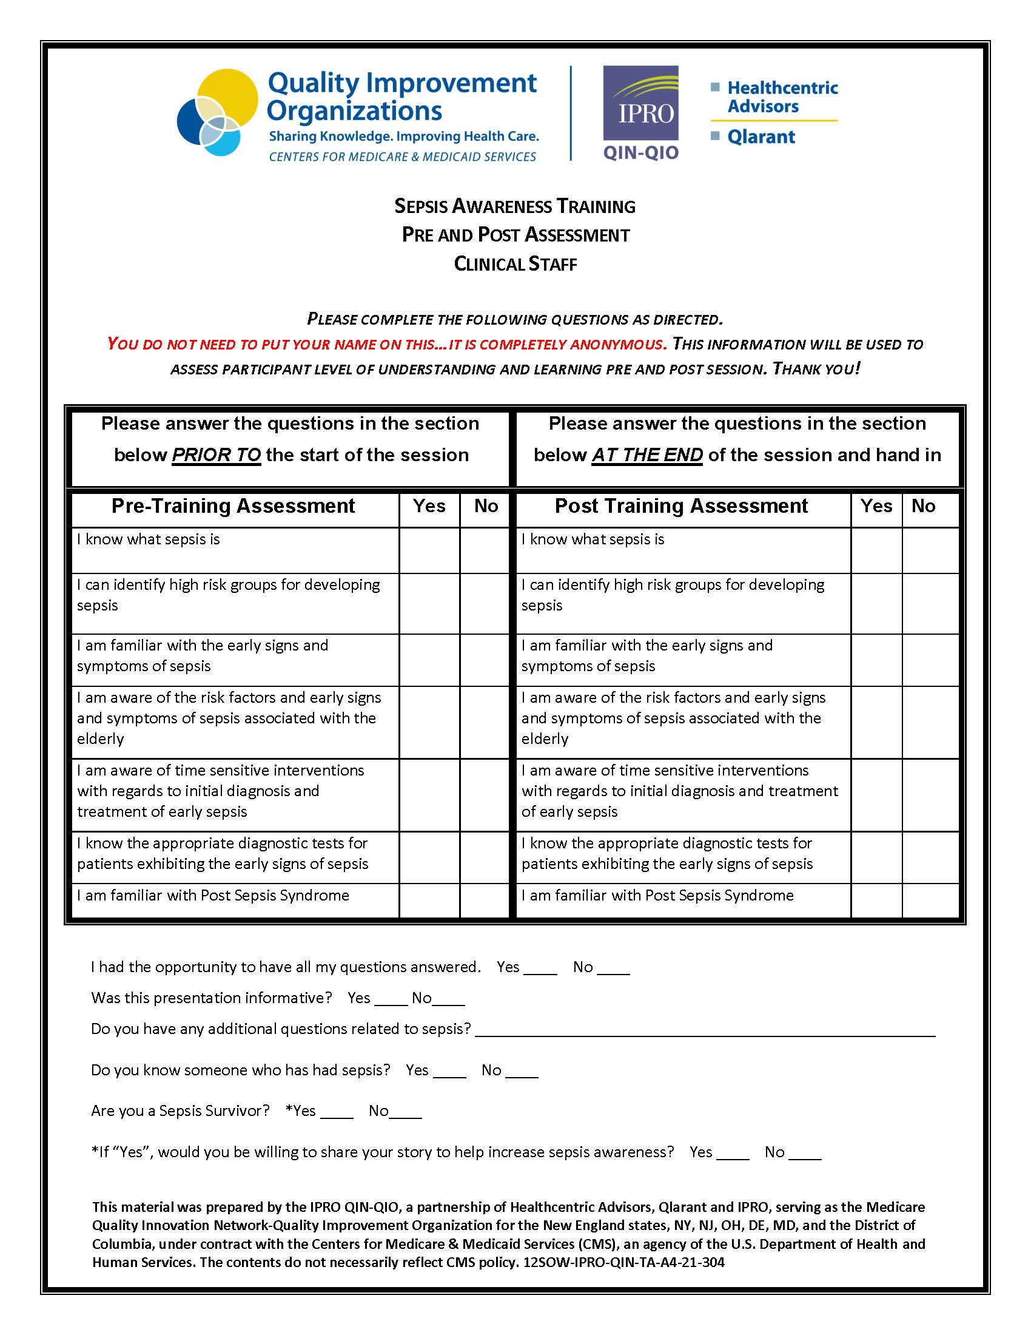
Please complete the
Pre-Training
Assessment questions prior to the start of the training session, thank you!
IPRO Sepsis Initiative
https://qi.ipro.org/sepsis/

Slide 6

Sepsis
Sepsis is a life-threatening condition that arises when the body’s response to an infection injures its own tissues and organs¹
Sepsis is a leading cause of death and
healthcare spending globally ^{2,3}
  Singer, et al. JAMA 2016;315(8) 801-810
  Fleischmann, et al. Am J Resp Crit Care Med. 2016; 193:259-272
  Iwashyna, et al. J Am Geriatr Soc. 2012;60:1070-1077
Notes:
Read brief paragraph about Sepsis Alliance.
The video you are about to view is very powerful and a compelling call to action.

Slide 7
Why Community Based?
> 87% of sepsis cases originate in the community ₁
Sepsis mortality is largely preventable with early detection and appropriate treatment
Just 58% of U.S. adults have heard of sepsis ₂
Sepsis diagnosis often missed by healthcare providers
Sepsis is the #1 reason for 30-day hospital readmissions
Sepsis Alliance
Sepsis Allaince
Notes:
Treatment for Sepsis is typically done in a hospital (either in the ED or as an in-patient)

Slide 8
Approach
  Educate: Sepsis is a Medical Emergency
  Improve sepsis care transitions between pre-hospital, acute care and post-acute healthcare and community settings
  Focus education on high-risk populations and the community
  Educate all levels of staff on early recognition of sepsis in the community
  Educate residents, families and care partners on signs and symptoms of sepsis
Notes:
Although much of the information in the upcoming slides was addressed in the video, the important messages about recognizing sepsis as a medical emergency and familiarizing yourself with the early warning signs certainly bear repeating

Slide 9

Sepsis Alliance Sepsis: Emergency Video
Sepsis: Emergency Video Available on Sepsis Alliance Website: https://www.sepsis.org
Notes:
The video you are about to view is very powerful and a compelling call to action.

Slide 10
Sepsis Awareness is Poor
Sepsis is one of the most under recognized and misunderstood conditions by healthcare providers and the public
The public needs an understandable definition of sepsis
Clinical prompts for healthcare providers facilitate earlier identification
  of sepsis
Public needs to know the signs and symptoms of sepsis and associate sepsis as a medical emergency

Slide 11
Sobering Statistics
  $27 billion spent annually treating sepsis in hospitals
  In-hospital mortality rate 8Xs higher than other diagnoses
Mortality rate for severe sepsis is 29%¹ which is greater than:
      AMI (25%)²
      Stroke (23%)³
      Trauma (1.5%)⁴
18 million people die of sepsis worldwide every year
Sepsis is the leading cause of childhood deaths
Sepsis is the most expensive condition treated in U.S. hospitals⁵
Sepsis kills 258,000 Americans annually⁶
Early diagnosis of sepsis is often missed
    JACC 1996
    American Heart Association. Heart Disease and Stroke Statistics- 2005 Update
    Crit Care Med 2001
    National Highway Traffic Safety Administration. Traffic Safety Facts 2003
    AHRQ
    CDC
Notes:
In fact, in a recent national survey, it was revealed that barely half of all Americans have heard of the term Sepsis. There is a lot of opportunity to educate and increase awareness about sepsis in the community and understanding that it needs to be treated as a medical emergency

Slide 12
In New York, over 50% of in-hospital mortality due to septicemia or severe sepsis in Medicare beneficiaries being transferred to the hospital by a nursing home facility prior to their admission, occurs within the first 6 days after admission.
New York State Medicare Fee-For-Service Beneficiaries referred to the hospital from a SNF/ICF or health facility transfer, who did not receive Home Health Care prior to admission.
Time frame: 1/1/2022 – 12/31/2022, Medicare Fee-for-Service Part A Claims
Sepsis Hospitalizations identified through: Sepsis Primary Diagnosis was present on admission. Source of Admission to Hospital was a Physician or Clinic Referral. Facility Transfers are Excluded. Patient Disposition was Expired.

Slide 13
In New York, 50% of in-hospital mortality due to septicemia or severe sepsis in Medicare beneficiaries receiving Home Health Care prior to their admission, occurs within the first 5 days after admission.
QIN-QIO Medicare Fee-For-Service Beneficiaries who Received Home Health Care Prior to Admission
Time frame: 1/1/2022 – 12/31/2022, Medicare Fee-for-Service Part A Claims
Sepsis Primary Diagnosis was present on admission. Source of Admission to Hospital was a Physician or Clinic Referral. Facility Transfers are Excluded. Patient Disposition was Expired.

Slide 14
In New York, 50% of in-hospital mortality due to septicemia or severe sepsis in Medicare beneficiaries being referred directly to the hospital by a physician or clinic prior to their admission, occurs within the first 6 days after admission.
New York State Medicare Fee-For-Service Beneficiaries referred to the hospital from a physician or clinic, who did not receive Home Health Care prior to admission.
Time frame: 1/1/2022 – 12/31/2022, Medicare Fee-for-Service Part A Claims
Sepsis Primary Diagnosis was present on admission. Source of Admission to Hospital was a Physician or Clinic Referral. Facility Transfers are Excluded. Patient Disposition was Expired.

Slide 15


Time to Treatment is Critical
Mortality increases by 8% for every hour that appropriate treatment is delayed
    Organ Failure
    Tissue Damage
    Death
Early identification and treatment are the keys to improved outcomes
Notes:
There are simple things that can minimize the risk of developing sepsis

Slide 16
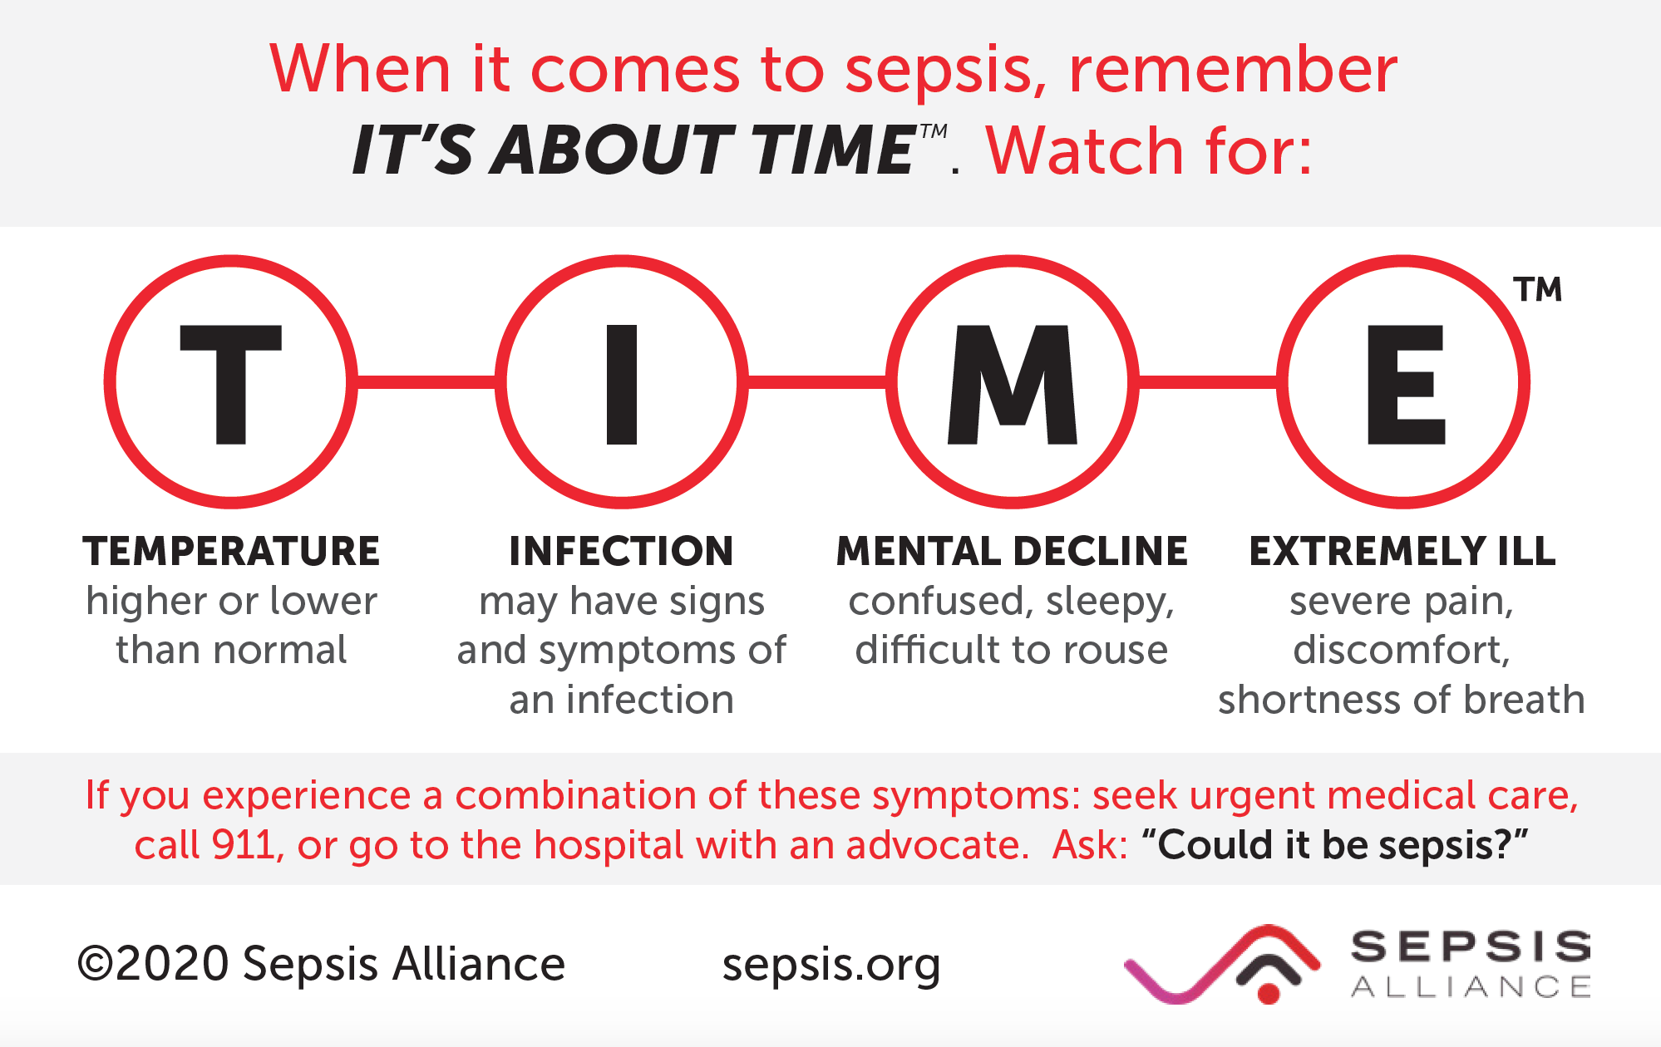
Sepsis

Slide 17

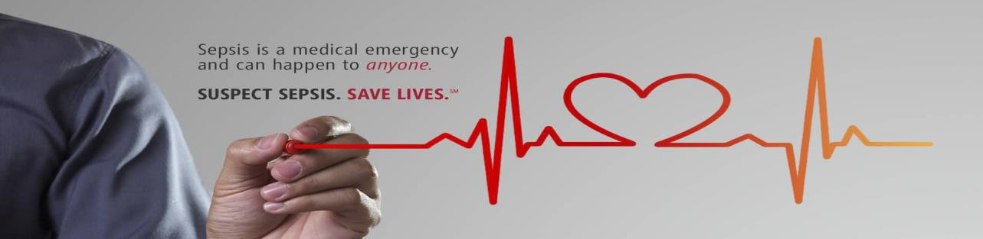
Identification of Sepsis

Slide 18
Sepsis Facts
Bacterial infections cause most cases of sepsis
Viral (COVID, Influenza) and fungal (Candida) infections can also cause sepsis
At least 350,000 adults who develop sepsis die during their hospitalization or are discharged to hospice
Sepsis related deaths increased with age among adults aged 65 or over
1 in 3 people who die in a hospital had sepsis during that hospitalization
Anyone can develop sepsis, the following groups of people are at higher risk; adults 65 or older, people with weakened immune systems, people with chronic medical conditions (diabetes, lung disease, cancer, kidney disease), people with recent severe illness or hospitalization, people who survive sepsis.
https://www.cdc.gov/nchs/products/databriefs/db422.htm
https://www.cdc.gov/sepsis/what-is-sepsis.html

Slide 19
Sepsis and Infection
Sepsis is always triggered by an infection
Sometimes people don’t know they have an infection
Sometimes the causative agent of the infection is not identified
Sepsis diagnosis is sometimes missed due to various manifestations of sepsis
Conversely: If symptoms of sepsis exist, a source of infection should be sought
Notes:
Read brief paragraph about Sepsis Alliance.
The video you are about to view is very powerful and a compelling call to action.

Slide 20
Early Signs of Sepsis
Sepsis always develops from a confirmed or suspected infection
with more than one of the following:
  Fever, shivering, feeling very cold
  Cool extremities or mottling of skin
  Rapid heart rate
  Rapid breathing
  Shortness of breath
  Confusion or difficult to arouse
  Complaints of extreme pain
  Pale/discolored skin
  Clammy sweaty skin
Notes:
Read brief paragraph about Sepsis Alliance.
The video you are about to view is very powerful and a compelling call to action.

Slide 21
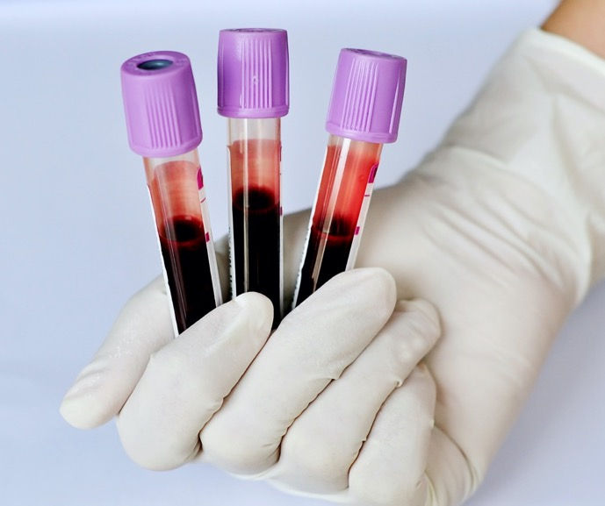
Other Early Signs May Include…
Decreased blood pressure
    (SBP <90mmHg or SBP decrease>40mmHg)
Other signs of altered mental status
Decreased urine output / dark, concentrated urine
Abnormal lab tests
      Increased lactate level
      Increased creatinine
      Decreased platelet count
      Coagulation abnormalities
      Hyperglycemia in absence of diabetes
Notes:
Treatment for Sepsis is typically done in a hospital (either in the ED or as an in-patient)

Slide 22
Sepsis-Associated Delirium
Confusion, agitation, coma
Occurs in one in every three to four patients with sepsis
Mechanisms not completely understood, but neuroinflammation, altered blood flow and neurotransmission, and disruption of blood-brain barrier have been demonstrated
Impairment can persist for months or longer
Screening tools essential to early detection and treatment
Avoid use of psychoactive drugs in management
Atterton, B., Paulino, M. C., Povoa, P., & Martin-Loeches, I. (2020). Sepsis Associated Delirium. Medicina, 56(5), 240. https://doi.org/10.3390/medicina56050240

Slide 23
Who is at Risk for Sepsis?
Anyone with an infection!
Those at higher risk for developing sepsis include:
    People 65 or older
    Infants less than 1 year old
    People with chronic illnesses: diabetes, cancer, AIDS
    People with weakened immune systems
    People recently hospitalized
    People recovering from surgery
    People who have had sepsis in the past
Notes:
Treatment for Sepsis is typically done in a hospital (either in the ED or as an in-patient)

Slide 24

Common Infectious Diseases That May Progress to Sepsis
Pneumonia
Skin Infections (cellulitis)
Urinary Tract Infections
Post-partum Endometritis
Influenza
Clostridioides difficile (C.diff) Enteritis
Tick-borne Infections especially in the immunocompromised
Notes:
Treatment for Sepsis is typically done in a hospital (either in the ED or as an in-patient)

Slide 25
2012 Definitions for Sepsis
Systemic Inflammatory Response Syndrome (SIRS)
SIRS is nonspecific and can be caused by: infection, inflammation, trauma, ischemia or several insults combined
SEPSIS = INFECTION + 2 OR MORE SIRS CRITERIA
SIRS Criteria:
  Fever >101°F
  Hypothermia <96.8°F
  Heart rate >90 beats/minute
  Respiratory rate >20 breaths/minute
  WBC >12 or <4 or >10% bands
  Note: SIRS can exist without progressing to sepsis
Notes:
Sepsis always develops from an infection

Slide 26
Progression of Sepsis
If not treated promptly, sepsis can progress!
INFECTION + 2 or more SIRS criteria
  SEPSIS
  SEPSIS + NEW ONSET ORGAN INJURY
  SEVERE SEPSIS
  SEVERE SEPSIS + REFRACTORY HYPOTENSION
  OR TISSUE HYPOXIA (ELEVATED LACTATE)
  SEPTIC SHOCK
Notes:
Knowing the early signs and symptoms of sepsis could help you save the life of a friend, co-worker, family member, loved one or yourself

Slide 27
2016 Definitions for Sepsis
  Third International Consensus Definitions for Sepsis and Septic Shock
  (Singer, et al. JAMA 2016;315(8) 801-810)
  Utilizes SOFA criteria: Sequential Organ Failure Assessment Score
qSOFA (Quick SOFA) Criteria:
  Better predictor of patient outcomes for non-hospital and non-ICU settings
  (vs. SIRS criteria)
  Appropriate and easy to use in the outpatient setting
  2 of the 3 criteria provides simple bedside criteria to identify adults with suspected infection who are likely to have poor outcomes
    Altered mental status
    Hypotension ( systolic <100mmHg)
    Increased respiration rate (>22 breaths per minute)
Notes:
Sepsis always develops from an infection

Slide 28
2016 Sepsis-3
Recommended elimination of the term “severe sepsis”:
  Sepsis defined as life-threatening organ dysfunction caused by a dysregulated host response to infection.
  Septic shock is a subset of sepsis with circulatory and cellular/metabolic dysfunction associated with a higher risk of mortality.

Slide 29

Initial Treatment Evidence Based
Consistent with Centers for Medicaid & Medicare Services: Management Bundle
Within 3 Hours of Presentation*
    Measure blood lactate level
    Obtain blood cultures (prior to giving antibiotics)
    Administer broad-spectrum IV antibiotics
    Administer 30ml/kg crystalloid for hypotension or lactate≥4mmol/L
      Recommended within 1st hour of recognition
Within 6 Hours of Presentation of Septic Shock
    Administer vasopressors (for hypotension that does not respond to initial fluid resuscitation) to maintain a mean arterial pressure (MAP) ≥65mmHg
    For persistent hypotension (MAP<65) or initial lactate ≥4mmol/L, reassess volume status and tissue perfusion
    Repeat lactate level if initial level was elevated
*Time of presentation is defined as the time of triage in the emergency department or, if presenting from another care venue, from the earliest chart annotation consistent with all the elements of severe sepsis or septic shock ascertained through chart review
Notes:
Sepsis always develops from an infection

Slide 30
Hour - 1 Bundle
Surviving Sepsis Campaign
Sepsis and septic shock are leading causes of death worldwide. Implement the Surviving Sepsis Campaign guidelines and the Hour-1 Bundle and be part of the international effort to reduce mortality and morbidity. Guidance for children is now also available.
Medical Emergency:
Initiate bundle upon reconciliation of sepsis/septic shock. May not complete all bundle elements within one hour of recognition.
Measure lactate level, re-measure lactate if initial lactate elevated (>2mmol/L)
Obtain blood cultures before administering antibiotics
Administer broad-spectrum antibiotics
Begin rapid administration of 30 mL/kg crystalloid for hypotension or lactate> mmol/L
Apply vasopressors if hypotensive during or after fluid resuscitation to maintain a mean arterial pressure > mm Hg
https://www.sccm.org/SurvivingSepsisCampaign/Home

Slide 31
The Legacy of Rory Staunton: Rory’s Regulations
In 2013, Governor Cuomo passed mandatory sepsis protocols for all New York hospitals¹
Developed by the Rory Staunton Foundation, Northwell Health and the NYS Department of Health
“Rory’s Regulations” require every Article 28 NYS hospital in NYS to adopt evidence-based protocols providing for:
    Early recognition and treatment of sepsis
    Staff training
    Collection of patient data for analysis by NYS DOH
      NY continues to use 2012 Sepsis Definitions
https://www.endsepsis.org/work/sepsis-protocols/
1. NYS Department of Health Sepsis Regulations: Guidance Document 405.4 (a)(4). 2019.
Notes:
We have a great opportunity to educate our co-workers, family and friends

Slide 32
Hospitalizations for Sepsis Increasing
  Increase in aging population (high-risk group)
  Increase in antibiotic resistant bacteria
  Increase in people with immunocompromising conditions

Slide 33
Patients Hospitalized for Sepsis
Are more severely ill than those hospitalized for other conditions
Have considerably longer lengths of stay in the hospital than those hospitalized for other conditions (median=10 days)¹
Are more likely to die during hospitalization compared to those hospitalized for other conditions
1. MMWR Vol.65 Aug.2016
Notes:
It is important educate people not to ignore these initial signs of sepsis.

Slide 34
Considerations for the Elderly
Elderly constitute 1/5 of the US population but 2/3 of patients admitted to the hospital with sepsis¹
Risk factors specific to this demographic
  Increased incidence of chronic co-morbidities²
  Prone to UTIs- a common source of sepsis
  Malnutrition is common in the elderly³
  Increased incidence of colonization by drug resistant bacteria ⁴
  Declining immune functionality (more susceptible to infections)
  Crit Care Med. 2006;34:15-21
  Crit Care Med. 2007;35:1244-1250
  North Am. 2001;30:313-334
  N Engl J Med. 1978;298:1108-1111

Slide 35
Relevance to SNFs
Skilled Nursing Facility providers treat and care for populations most vulnerable to sepsis
      Skilled Nursing Providers are a critical link to preventing, recognizing, and treating sepsis
      Early identification of sepsis in the SNF care setting will promote rapid treatment response either in house or referral to the next level of care
Targeting sepsis as a public health concern, addresses major factors affecting: Quality of healthcare, potentially avoidable hospitalizations and cost
Notes:
Read brief paragraph about Sepsis Alliance.
The video you are about to view is very powerful and a compelling call to action.

Slide 36
Special Considerations for SNF Residents
Urinary tract infections (UTIs) are a common source of sepsis
  Elderly are more at risk for UTIs
  Especially those with indwelling urinary catheters
  UTI symptoms can differ from those of younger people
        Confusion
        Agitation
        Poor motor skills or dizziness
        Falling
        Other behavioral changes
UTIs in elderly are often mistaken for early dementia or Alzheimer's Disease (NIH)

Slide 37
Sepsis Risk Factors for Readmission
Older adults who were discharged to a Skilled Nursing Facility (SNF) after hospitalization for pneumonia or sepsis are susceptible to various causes of readmission including infectious, circulatory, respiratory, and genitourinary causes
There is a need for close monitoring for infections during the early post-discharge period
Additional interventions should be custom tailored for the individual considering their comorbidities and the risk of specific readmission diagnoses
Improved communication strategies between hospitals and SNFs may help reduce potentially preventable hospital readmissions
Riester MR, et al. PLoS ONE. 2022;17(1):e0260664.

Slide 38
Sepsis and Readmission
Study of Medicare beneficiaries found that those who survived hospitalization for sepsis, 40% were readmitted within 90 days
Patients discharged after treatment for sepsis have high rates of hospital readmissions for chronic medical conditions (CHF, COPD, Acute Renal Failure)
Patients > 65 years of age- reasons for readmission within 90 days
  1.8% readmitted for aspiration pneumonia
  11.9% readmitted for infection (sepsis, pneumonia, urinary tract infection and skin and soft tissue infection.
  5.5% readmitted for CHF
  3.3% readmitted for acute renal failure
Enhancing Recovery from Sepsis; JAMA 2018; 319: 62-75

Slide 39
Post Sepsis Syndrome
Affects up to 50% of sepsis survivors
Post-sepsis syndrome is a condition that can result in physical and/or psychological long-term effects, such as:
    Impaired cognitive function-especially among older patients
    Mobility impairments (muscle weakness)
    Amputations
    Hallucinations
    Loss of self-esteem
    Increased dependency on others
    *Higher risk for patients with an ICU or extended hospital stay
Significant Impact on Caregivers
    Inadequate hospital discharge education on what to expect during recovery
    Difficulty accessing follow-up community treatment
    Cost
    Disruption to their lives

Slide 40
Post Sepsis Monitoring
If evidence of swallowing impairment- consider referral to speech therapy
Screening for depression and anxiety if needed
Medication reconciliation- discontinue hospital medications without an ongoing indication
Ensure receipt of vaccines, as appropriate
Monitor for signs and symptoms of infection

Slide 41
Antibiotic Stewardship versus Treating Sepsis
Not a Conflict in Strategies!
Stressed in all Training and Community Outreach Events
Urgent antibiotic therapy is needed for bacterial infections to prevent progression to sepsis and septic shock
Growing focus on appropriate use of all antibiotics both in and out of the hospital
Discourage empiric prescribing for upper respiratory tract infections and non-specific febrile and viral syndromes

Slide 42
Infection Prevention
Hand hygiene
Limit use of urinary catheters
Pneumococcal, influenza, COVID vaccination
Prompt identification and isolation of residents with viral respiratory illness
Tuberculosis screening
Antibiotic stewardship
Employee health
Outbreak containment protocols
Infection control policies and procedures
Smith, P. W., Bennett, G., Bradley, S., Drinka, P., Lautenbach, E., Marx, J., Mody, L., Nicolle, L., & Stevenson, K. (2008). SHEA/APIC Guideline: Infection prevention and control in the long-term care facility. American Journal of Infection Control, 36(7), 504–535. https://doi.org/10.1016/j.ajic.2008.06.001

Slide 43
Preventing Sepsis
Simple measures you can take:
        Practice good hand hygiene
        Try to avoid infections
        Treat infections promptly
        Get vaccinated!
        Maintain good overall health
Share & introduce the IPRO brochure
“Sepsis: Every Minute Counts!”
IPRO Sepsis Initiative
https://qi.ipro.org/sepsis/
English & Spanish
Notes:
Treatment for Sepsis is typically done in a hospital (either in the ED or as an in-patient)

Slide 44
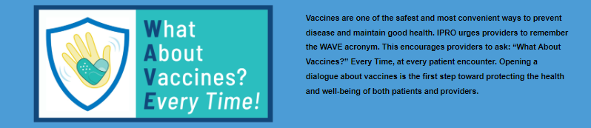
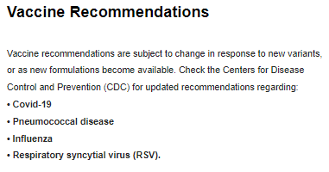
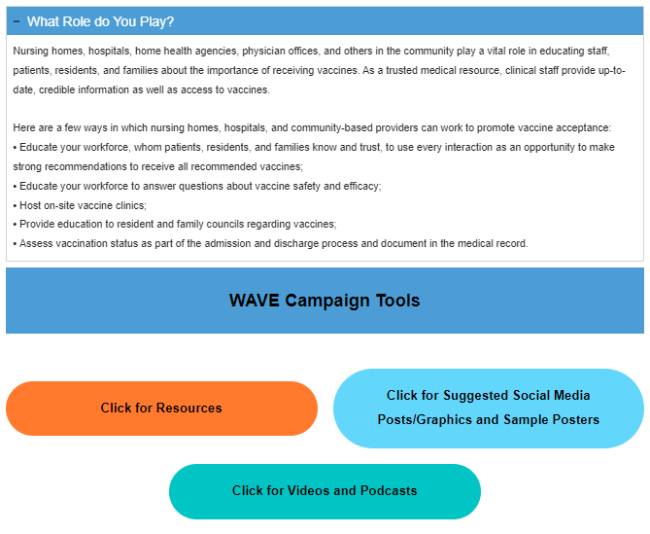
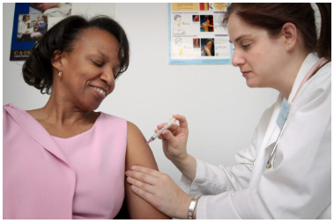
https://qi.ipro.org/home/what-about-vaccines-at-every-encounter/

Slide 45

Every Minute Counts!
TREAT SEPSIS AS A MEDICAL EMERGENCY
NOTIFY PHYSICIAN ASAP IF RESIDENT EXHIBITS THE SIGNS OF SEPSIS
Sepsis is treatable and can be prevented from progressing to septic shock…BUT it must first be suspected!
Early, prompt recognition and treatment improves survival rates
1. Crit Care Med,2006; 34: 1589-96.
Notes:
Sepsis can progress very quickly, so prompt medical attention is extremely important in preventing sepsis related complications and even death

Slide 46
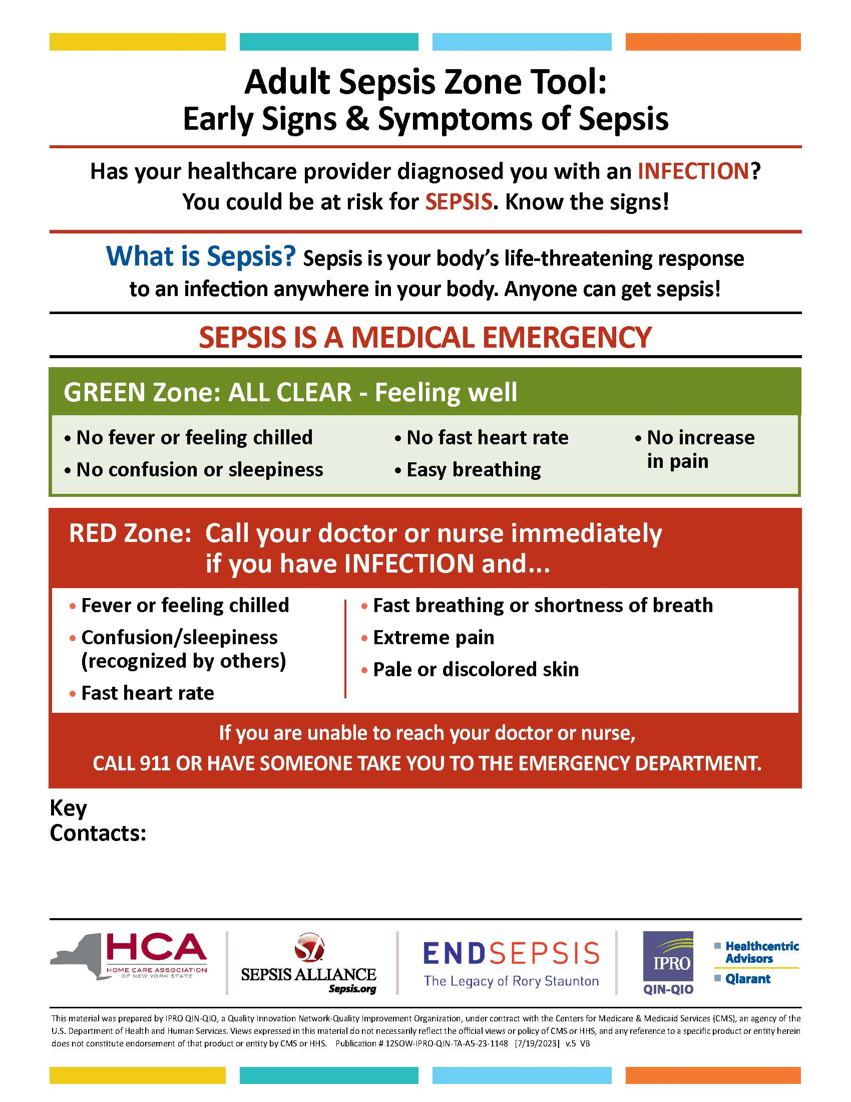
IPRO Adult Sepsis Zone Tool
English and Spanish
Patient information sheet to self-monitor for the early signs and symptoms of sepsis
Provide this for residents that have either been diagnosed with an infection or are at high risk for developing an infection
IPRO Sepsis Initiative
https://qi.ipro.org/sepsis/

Slide 47
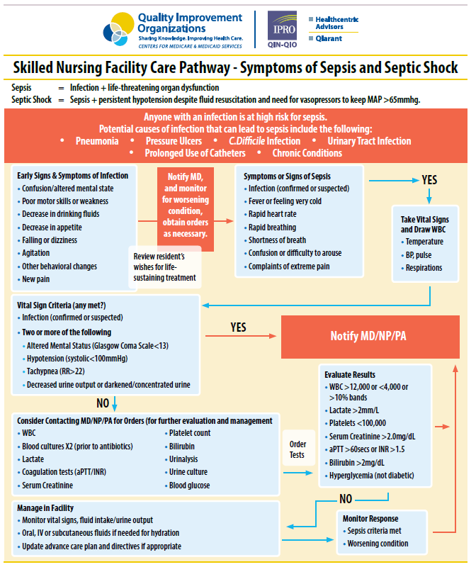
IPRO Sepsis Initiative
https://qi.ipro.org/sepsis/

Slide 48
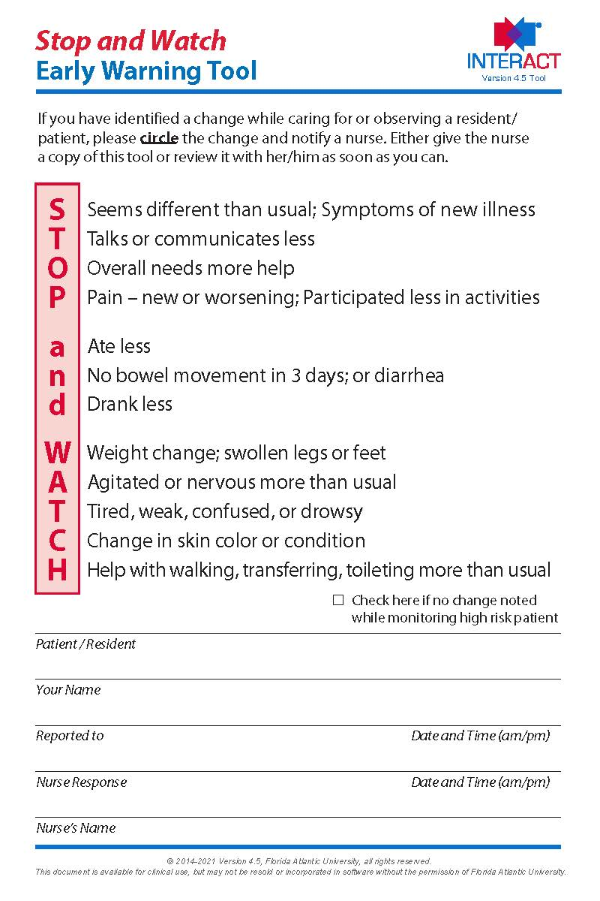
Interventions to Reduce Acute Care Transfers (INTERACT) Stop & Watch Tool
Pathway INTERACT® – Training, Tools, Licensing and Resources (pathway-interact.com)

Slide 49


Slide 50
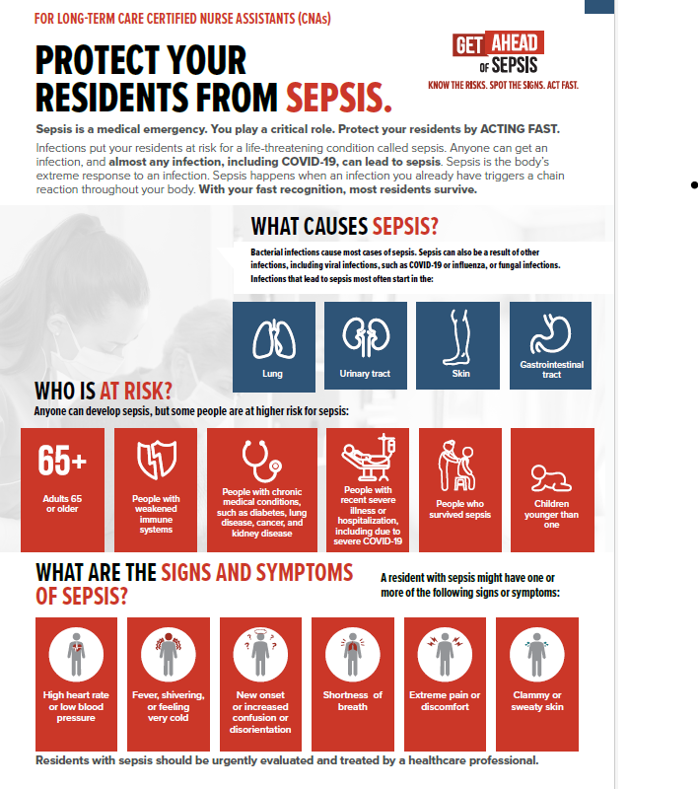
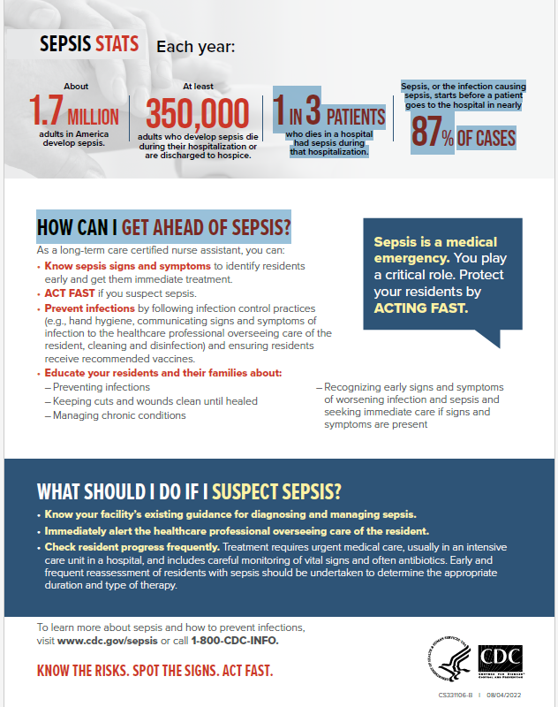

Slide 51
Talking with Residents & Families
Could this be sepsis??
Start the discussion by asking if they have heard of sepsis
(If they have let them tell you what they know)
Share key points about sepsis:
  The body’s overactive/often life-threatening response to an infection anywhere (skin, urine, respiratory etc.)
  Anyone with an infection may be at risk for developing sepsis
  Early signs and symptoms; fever/feeling cold, sleepy/confused, short of breath, rapid heart rate, decreased/dark urine
  It’s important that you let your caregiver know if you experience any of the above
    Sepsis is a medical emergency!

Slide 52
How You Can Help
Familiarize yourself with the early signs of sepsis
Know who is at high risk for sepsis
Educate residents, family, friends and loved ones about the signs & symptoms of sepsis
Be cognizant of health literacy and its implications:
    Explain information to patients in a manner they can understand
        Teach Back Method

Slide 53
Please complete Post Training Assessment questions and hand in to presenter at the end of training session
Thank you!
IPRO Sepsis Initiative
https://qi.ipro.org/sepsis/

Slide 54
Sepsis Web-based Training & Resources

Slide 55
Staff Engagement and Anticipated Challenges
Training Opportunities
  New staff orientation
  Annual competency training
  Staff meetings
  Sepsis survivor lived experience sharing

Slide 56
Discussion & Sharing
What sepsis protocols or practices do you have in place in your facility?
Ideas for cross-setting collaboration
  Hospitals
    At the time of intake/transition
    With Triage if sepsis identified
  Home Health
  Primary Care Physician Offices

Slide 57
Resources
CDC “Get Ahead of Sepsis Campaign”:
https://www.cdc.gov/sepsis/get-ahead-of-sepsis/index.html
Sepsis Alliance:
http://www.sepsis.org/
Rory Staunton Foundation:
https://www.patientcarelink.org/the-rory-staunton-foundation-for-sepsis/
IPRO Sepsis Initiative
http://stopsepsisnow.org
Surviving Sepsis Campaign:
http://www.survivingsepsis.org/Pages/default.aspx

Slide 58
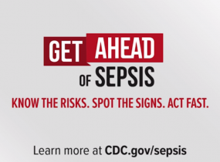
CDC Get Ahead of Sepsis Campaign
https://www.youtube.com/watch?v=5JvGiAFLels

Slide 59

Our Ask…..Please Go Forth & Train!
In Order To……….
Maximize the information learned today
Improve staff knowledge on sepsis
Promote early identification of sepsis in residents
Achieve improve resident outcomes related to sepsis
Our Ask…….
Conduct at least one Sepsis Training for clinical staff & one for non-clinical staff within your facility

Slide 60




What are you going to do by next Tuesday?
Discuss with Medical Director & Physicians
Share Sepsis Zone Tool with residents, families and all facility discharges
Schedule clinical & non-clinical staff training
Encourage staff to discuss with their family & friends to increase sepsis awareness
Add “History of Sepsis” to intake screening process

Slide 61
Voices From The Field
The sepsis training is now part of our monthly orientation curriculum as well. We have had quite a few success stories since rolling out this program; the most notable was a febrile vent patient for whom we were able to avoid a hospitalization by implementing early intervention of IV fluids and antibiotics ... the symptoms were recognized by a nurse who had taken the class an hour prior!
There is a good response from our staff on this training, they are thankful. The material is really user-friendly. That trainer's course I attended was really a big opportunity for me and the facility. We will work on expanding Sepsis Awareness to include our residents here and their families.
I'd like to personally thank you for the opportunity to participate in this essential program! It has been well-received at our facility by clinical and non-clinical personnel alike.
As you suggested, I have made sepsis training a mandatory part of our orientation process as well as yearly competency training for all staff. I have added the pathway to all of the nurse medication carts as a quick reference as well.
Staff are surprised at the statistics regarding sepsis. Everyone has been very receptive to the education of sepsis, which I am very happy to see!
Trainings are going well, lots of good feedback! It actually has been pretty fascinating to me that at practically EVERY session, someone has come up to me to tell me a personal story about someone they knew who had sepsis, several who have died. Wow! The staff have been engaged and interested. Verbal feedback from staff has been positive!

Slide 62


Questions / Feedback

Slide 63
Contact Information
Sara Butterfield, RN, BSN, CPHQ
Assistant Vice President, Healthcare Quality Improvement Program
IPRO
518-320-3504
sbutterfield@ipro.org
IPRO Stop Sepsis Now
https://qi.ipro.org/sepsis/

Slide 64


Learn More & Stay Connected
https://qi.ipro.org/
Follow IPRO QIN-QIO
This material was prepared by the IPRO QIN-QIO, a Quality Innovation Network-Quality Improvement Organization, under contract with the Centers for Medicare & Medicaid Services (CMS), an agency of the U.S. Department of Health and Human Services (HHS). Views expressed in this material do not necessarily reflect the official views or policy of CMS or HHS, and any reference to a specific product or entity herein does not constitute endorsement of that product or entity by CMS or HHS. Publication # 12SOW-IPRO-QIN-T1-A2-23-988
Notes:
Host: You can connect with us for assistance and additional tools through our website. We encourage you to visit our Resource Library and will share the direct link to the library in chat. Next slide please.

