Slide 1
Falls: The Series
May - October 2023
Population-Specific Fall and Fall-Injury Prevention
Coaching Session 5 – September 20, 2023
This material was prepared by the IPRO NQIIC, a Network of Quality Improvement and Innovation Contractor, under contract with the Centers for Medicare & Medicaid Services (CMS), an agency of the U.S. Department of Health and Human Services (HHS). Views expressed in this material do not necessarily reflect the official views or policy of CMS or HHS, and any reference to a specific product or entity herein does not constitute endorsement of that product or entity by CMS or HHS. Publication # IPRO-HQIC-Tsk56-23-354

Slide 2
IPRO HQIC/QIN-QIO

Slide 3
Series Schedule: 2 – 3 pm EST
Date | Session #/Topic
Wednesday, May 3 | 1. Enhancing Capacity – Reengineering Fall and Fall Injury Programs: Infrastructure, Capacity, and Sustainability
Wednesday, June 7 | 2. Redesigning Post-Fall Management: Prevent Repeat Falls
Wednesday, July 5 | 3. Best Practices to Reduce Falls Associated with Toileting
Wednesday, August 2 | 4. Safe Mobility is Fall Prevention
Wednesday, September 6 | 5. Population-Specific Fall and Injury Prevention
Wednesday, October 4 | 6. Reducing Fall-Related Injuries: Protective Interventions’ Evidence, Application, and Success

Slide 4
Your Participation Will
Support organizational systems and teams to expand program infrastructure and capacity;
Help you redesign your fall prevention and injury reduction program;
Complement your evaluation program; and
Provide access to an online learning community to increase exchange of experiences, innovations, and best practice implementations.

Slide 5
Series Speaker
Patricia A. Quigley, PhD, APRN, CRRN, FAAN, FAANP, FARN
Nurse Consultant
Dr. Quigley is the President and Managing Member of Patricia A. Quigley, Nurse Consultant, LLC, which provides consultation to healthcare systems and patient safety organizations to advance patient safety programs and re-engineer integration of innovation at the point of care.
For more than 45 years, Dr. Quigley has practiced in the field of rehabilitation nursing. She is recognized for her leadership as a speaker, scholar, researcher, author, educator, and mentor.
Dr. Quigley’s contributions to patient safety, nursing, and rehabilitation are highly respected both nationally and internationally. She is known for her emphasis on clinical practice innovations designed to promote independence and safety for the elderly.
Dr. Quigley is currently a member of the National Quality Forum’s Prevention and Population Health Committee.

Slide 6
A Refresher: Population-Specific Fall and Fall-injury Prevention
Patricia Quigley, PhD, APRN, CRRN, FAAN, FAANP, FARN
September 20, 2023

Slide 7
Learning Outcomes
Utilize clinical expertise to define fall risk factors for 3 clinical populations
Realign patient outcomes from fall rates to mitigation and elimination of fall risk factors for preventable falls
Apply nursing process to evaluate individualized patient response to care planning

Slide 8
What we Know…..
Not all falls are equal
Universal fall prevention bundles are not effective
Forced immobility is causing harm
”Non-compliance” is overused
Misuse of bed alarms cause more harm than good
Falls are not just a nursing issue
Staff are still getting injured

Slide 9
Develop Comprehensive Design 3-Tier Fall and Injury Care Plan Program
1. Universal fall precautions – still individualized-based Patient Assessment and Nursing Clinical Judgement
2. Individualized care plan –
Align fall risk factor to specific intervention
Individualized protection from injury based on injury risk
3. Implement Population-Based Approach To Fall and Injury Prevention
Dx: Rt CVA vs Lt CVA; A,B,C,S; Parkinson’s Dis vs. Alzheimer’s Dis)
Risk adjust based on population: age—based

Slide 10
Universal Fall Precautions
They apply to all patients for the most part.
The purpose is to keep all patients safe.
The choice of precautions varies by hospital.
All staff who interact with patients should be trained on universal fall precautions for each patient.
Fall prevention becomes embedded into hospital safety culture.

Slide 11
Fall Risk Screening/Assessment
1. Fall Risk Screening/
Assessment
2. Tailored/Personalized Care Planning
3. Consistent Preventive Interventions
● Universal precautions
● Tailored interventions to address patient-specific areas of risk
Use a reliable, prospectively validated scale. A tool that:
Helps identify patients at risk for anticipated physiological falls
Provides basis for tailored or personalized care planning
3-Step Fall Prevention Process
Notes:
American Geriatrics Society, 2010
Ganz DA, Huang C, Saliba D, et al., 2013
Centers for Disease Control and Prevention

Slide 12
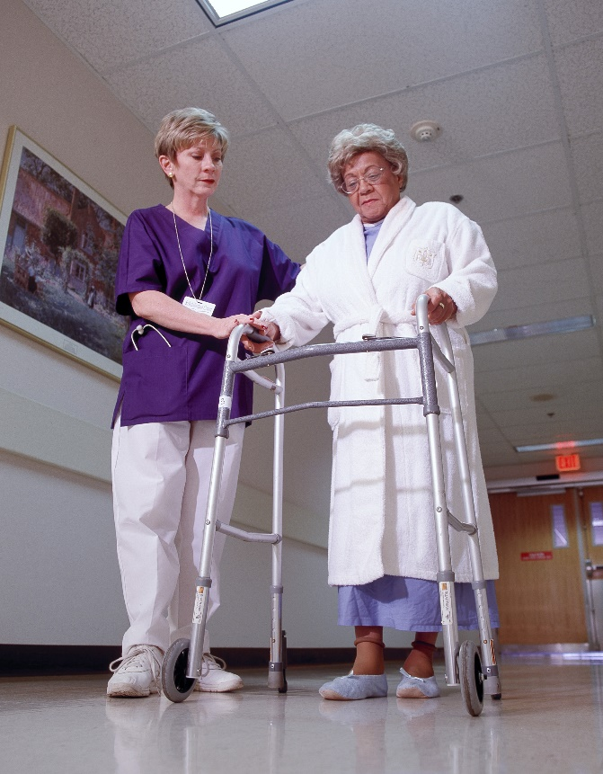
Key Factors To Assess for Fall Risk
History of falls
All patients with a recent history of falls in the past 3 months
Patients admitted due to a fall – the known faller - Etiology?
Mobility status
Mobility problems and use of assistive devices
Muscle strength, peripheral neuropathy, proprioception
Ability to use devices

Slide 13
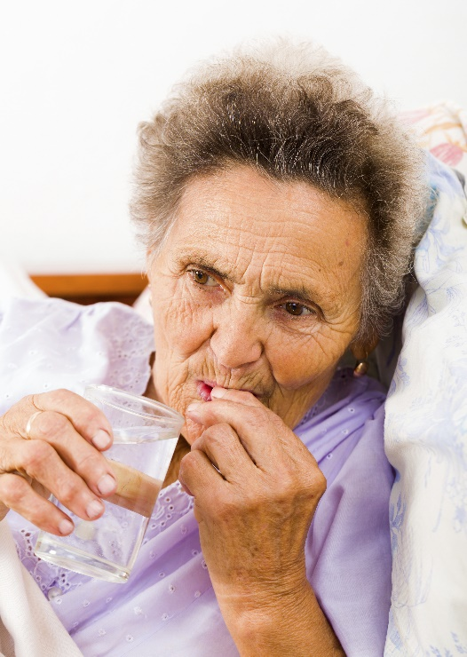
Key Risk Factors for Falls
Medications
Patients taking a large number of medications that could cause sedation, confusion, impaired balance, or orthostatic blood pressure changes are at higher risk for falls.
Mental status
Patients with delirium, dementia, or psychosis may be agitated and confused, putting them at risk for falls.

Slide 14
Key Risk Factors for Falls
Continence
Patients who have urinary frequency, or who have frequent toileting needs, are at higher risk
Volume/electrolytes
Electrolyte imbalances and known and significant predictors of higher fall risk
Hydration status affects orthostasis

Slide 15
Key Risk Factors for Falls
Communication/sensory
Communication failures are a major contributor to medical errors and sentinel events
This includes staff to patient communication
Patients with neuropathy are at higher risk for proprioception issues and need individualization with even universal fall precautions r/t footwear
Behavior
Non-compliance with instruction is a key indicator of risk
Impulsive patients need different approaches to care that are more proactive

Slide 16
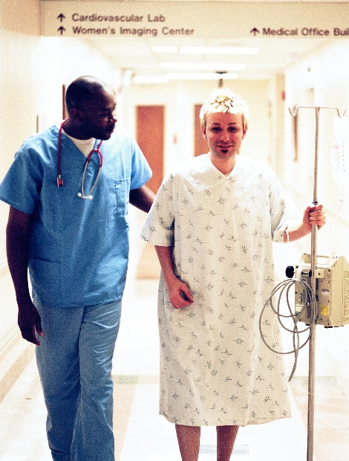
Tailoring Practices
The practices selected and used need to be tailored to your program and the type of patients and care flow on individual units – populations and settings of care.

Slide 17
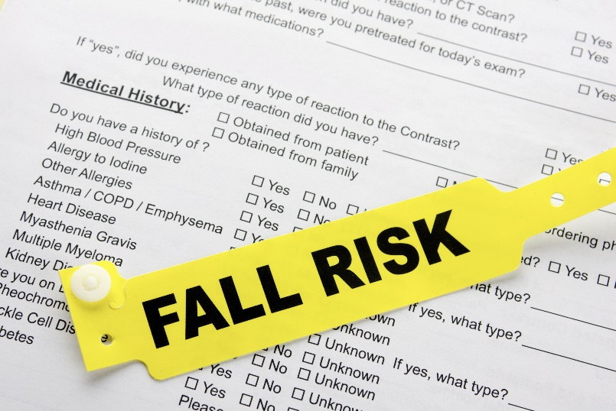
Fall Prevention Care Planning
It is not enough to know which patients have risk factors for falls.
Care planning guides staff on how to prevent falls.
Care planning is a process whereby the patient’s risk information is translated into an action plan, ensuring continuity of care.

Slide 18
Unit-Level Fall Risk Factors
Add unit-level risk factors are needed
For example, on a general cardiac care unit, orthostatic hypotension due to medications may be a fall risk factor
Evaluate orthostatic vital signs
Other examples: PCU, Neuro, Orthopedic
Examine patient engagement and education effectiveness

Slide 19
Evidence-based Fall and Injury Risk Factors for Specific Populations CHF TIA - Stroke Hip Fracture Case studies help you to develop assessment and care/fall prevention interventions based on fall risk factors per population based for preventable falls (Accidental and Anticipated Physiological Falls).

Slide 20
CHF
Predisposing Fall Risk Factors
Impulsivity
Impaired safety awareness/overestimate abilities
Impaired problem solving
Hemiparesis/hemiplegia
Incontinence
Exercise intolerance
Respiratory symptoms
Reduced cognitive function
Orthostatic hypotension
Dependency in ADLs

Slide 21
Meet Your Grandmother
Notes:
Just turned 100…and yep, still smoking! Cognitively alert, independent in ADLs, walks with a cane for increased stability, wears hip protectors because she had a hip fracture at 92 years of age, when she was still living at home alone. Now, she is living in assisted living – help with housekeeping, shopping.
Med Hx:
Osteoporosis
Coronary Artery Disease (takes Crestor, 40 mg q day)
Irregular Heart Rate, Lanoxin 0.125 mg daily
Hip Fracture
No longer drives
Enjoys a shot of whiskey before bed
Presents to you ER with SOB, Diminished breath sounds bilarterly,

Slide 22
Individualized Care Plan – High Fall Risk
Create a Safe Environment – Reduce Accidental Fall
Bed placement – closest to room doorway (increase surveillance)
Safe bed exit: her prominent side
Working side of the bed
High-back captain’s chair
Bedside commode
Low bed position when resting/floor mat
Socks and Shoes for all mobility (left foot drop)
O2 tubing
Align Intervention to Fall Fisk Factors – Reduce Anticipated Physiological Fall
Response to O2
Energy conservation
Small tasks
Progressive moderate exercise
Scheduled, individualized toileting
Medication monitoring
Assisted ADLs
Anxiety
Insomnia
Notes:
https://www.healthline.com/health/congestive-heart-failure#stages

Slide 23
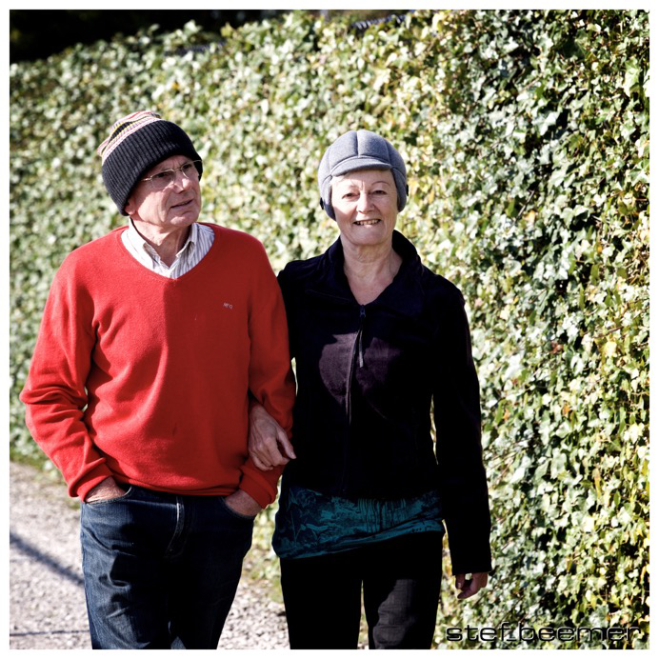
Meet Your Mother

Slide 24
She Suffered a TIA – Rt CVA
65 yoa, married, was working full time, recently retired high school math teacher, trouble coping with retirement
5 ft 5 ins, 145 lbs;
PHM: HTN, DMII, osteoporosis
Watching TV had left sided weakness, slurred speech
On arrival to ED, symptoms resolved
Dx TIA, ? Stroke in progress
Notes:
Source> https://www.physio-pedia.com/Case_Study:_Traumatic_Brain_Injury_in_an_Elderly_Woman

Slide 25
Your Mother’s Initial Fall Prevention Care Plan – ER – Anticipate Change in Status
Create a Safe Environment – Reduce Accidental Fall
Create safe exit side: if possible, move left side of bed next to wall
Floor mat to right side of bed
Move furniture away from right side of bed
No non-skid socks/closed shoes
BSC
Stretcher sensor
Continuous observation
Align Intervention to Fall Fisk Factors – Reduce Anticipated Physiological Fall
Mobility – CGA/SBA
BP/P - postural hypotension
Continence - scheduled toileting (don’t ask if needs to go to BR)
Medications – teach back
Partnership - patient education - teach back
Mental status - over-estimate ability

Slide 26
In Next Hour, Change in Status Added Assessment
Begins to garble speech
Inconsistently follows directions (one, two step commands)
Unaware of her impairments
Sensory technology for stretcher
Inconsistently oriented to person, time and space
Sitter

Slide 27
Your Father’s Hip Fracture - Falls at Bedside: Orthopedic Unit
Notes:
The team needs to consider sobering statistics such as these from the Centers for Disease Control and Prevention:
In the next 13 seconds, an older adult will be treated in a hospital emergency department (ED)for injuries related to a fall.
In the next 20 minutes, an older adult will die from injuries caused by a fall.
Falls cause more than half (55%) of traumatic brain injuries among children ages 0 to 14 years.
People ages 85 and older are 10 to 15 times more likely to sustain hip fractures than are those ages 60 to 65.
These statistics reflect the vulnerability of those we care for and must drive changes in practice. They should support changes to your fall and fall-injury programs that are population-specific based on age group, injury risk, and gender. As a start, every organization should answer the following three questions:

Slide 28
Hip Fracture Fall Risk Factors
Environmental
Suboptimal height – bed, chair, toilet
Required mobility device
Footwear
Floor mat
Hip protectors
Intrinsic (I)/Extrinsic(E)
Pain
Impaired mobility
Decreased balance
Decreased ROM
Altered ADLs
Assisted toileting
Medications
Overestimate abilities

Slide 29
With Clinical Experts, Create Population-Specific Fall and Injury Care Plans Based on Hip Fx patients, Along with Strategies to Monitor Patient Response to Care
Med scheduling management: pain management
Continued eval of safe use of assistive devices
Height adjusted furniture
Safe exit sides
Management of post fall stress anxiety if present
Adequate staff assistance with transfers
Assisted and monitored toileting
Floor mats

Slide 30
Your Time to Share
What topics are you interested in implementing?
What steps have you taken since our webinar?
What questions do you have?

Slide 31
Other Questions and Comments
How else can I help you?

Slide 32
Our Webinar Schedule
Webinar 1: May 3, Enhancing Capacity: Reengineering Fall and Fall Injury Programs: Infrastructure, Capacity and Sustainability
Coaching Session: May 17, Open Forum, Discussion
Webinar 2: June 7, Redesigning Post Fall Management
Coaching Session: June 21, Open Forum, Discussion
Webinar 3: July 5, Best Practices to Reduce Falls Associated with Toileting
Coaching Session: July 19, Open Forum, Discussion

Slide 33
Our Webinar Schedule (con’t)
Webinar 4: August 2, Safe Mobility is Fall Prevention
Coaching Session: August 16, Open Forum, Discussion
Webinar 5: September 6, Population-Specific Fall and Fall-injury Prevention
Coaching Session: September 20, Open Forum, Discussion
Webinar 6: October 4, Reducing Fall-related Injuries: Protective Interventions, Evidence and Application
Closing Coaching Session: October 18, Open Forum, Discussion
Thank you!

Slide 34
Thank you! You Can Always Reach Me!
Patricia Quigley, PhD, MPH, ARNP, CRRN, FAAN, FAANP, Nurse Consultant
pquigley1@tampabay.rr.com

Slide 35
Next Steps
Join us for our next Learning Series call: October 4, 2023, 2-3 pm EST
Falls series recording and slides: https://qi.ipro.org/2023/04/19/fall-and-injury-prevention-a-6-part-webinar-series/

Slide 36
IPRO HQIC & Speaker Contact Information
Rebecca Van Vorst MSPH CPHQ
Senior Director Quality Improvement
IPRO HQIC Project Manager
rvanvorst@ipro.org
CarlaLisa Rovere-Kistner, LCSW, CCM, CPHQ
Quality Improvement Specialist
IPRO
crkistner@ipro.org
Melanie Ronda, MSN, RN
Director, Health Care Quality Improvement
IPRO QIN-QIO
Nursing Home Lead, NY, NJ, Ohio
Infection Prevention Specialist
mronda@ipro.org
Amy Stackman, RN
Quality Improvement Specialist
IPRO QIN-QIO
astackman@ipro.org

Slide 37
Thank You for Attending Today’s Event
We value your input!
Please complete the brief survey after exiting event.

