Slide 1
Falls: The Series
May - October 2023
Best Practices to Reduce Falls Associated with Toileting
Coaching Session 4 – August 16, 2023
This material was prepared by the IPRO NQIIC, a Network of Quality Improvement and Innovation Contractor, under contract with the Centers for Medicare & Medicaid Services (CMS), an agency of the U.S. Department of Health and Human Services (HHS). Views expressed in this material do not necessarily reflect the official views or policy of CMS or HHS, and any reference to a specific product or entity herein does not constitute endorsement of that product or entity by CMS or HHS. Publication # IPRO-HQIC-Tsk56-23-325

Slide 2
IPRO HQIC/QIN QIO

Slide 3
Series Schedule: 2 – 3 pm EST
Date | Session #/Topic
Wednesday, May 3 | 1. Enhancing Capacity – Reengineering Fall and Fall Injury Programs: Infrastructure, Capacity and Sustainability
Wednesday, June 7 | 2. Redesigning Post-Fall Management: Prevent Repeat Falls
Wednesday, July 5 | 3. Best Practices to Reduce Falls Associated with Toileting
Wednesday, August 2 | 4. Safe Mobility is Fall Prevention
Wednesday, September 6 | 5. Population-Specific Fall and Injury Prevention
Wednesday, October 4 | 6. Reducing Fall-Related Injuries: Protective Interventions’ Evidence, Application and Success

Slide 4
Your Participation Will:
Support organizational systems and teams to expand program infrastructure and capacity;
Help you redesign your fall prevention and injury reduction program;
Complement your evaluation program; and
Provide access to an online learning community to increase exchange of experiences, innovations, and best practice implementations.

Slide 5
Series Speaker
Patricia A. Quigley, PhD, APRN, CRRN, FAAN, FAANP, FARN
Nurse Consultant
Dr. Quigley is the President and Managing Member of Patricia A. Quigley, Nurse Consultant, LLC, which provides consultation to healthcare systems and patient safety organizations to advance patient safety programs and re-engineer integration of innovation at the point of care.
For more than 45 years, Dr. Quigley has practiced in the field of rehabilitation nursing. She is recognized for her leadership as a speaker, scholar, researcher, author, educator, and mentor.
Dr. Quigley’s contributions to patient safety, nursing, and rehabilitation are highly respected both nationally and internationally. She is known for her emphasis on clinical practice innovations designed to promote independence and safety for the elderly.
Dr. Quigley is currently a member of the National Quality Forum’s Prevention and Population Health Committee.

Slide 6
IPRO Coaching Webinar
Pat Quigley,PhD,MPH,Aprn,CRRN,FAAN,FAANP, FARN
Nurse Consultant
E-Mail: pquigley1@tampabay.rr.com

Slide 7
Coaching Webinar Series Objectives:
Provide an open forum for sharing, collaboration and support
Compose strategies to reduce barriers and enhance facilitators to short-term and long-term program implementation
Address additional areas of fall program management as a community of learning

Slide 8
A Refresher: IPRO: Safe Mobility is Fall Prevention
Patricia A. Quigley, PhD, MPH, APRN, CRRN,
FAAN, FAANP, FARN, Nurse Consultant
August 16, 2023
e-mail: pquigley1@tampabay.rr.com

Slide 9
Objectives: Safe Mobility and Fall Prevention
Distinguish Models for Managing Risk for Falls Due to Unsafe / Unassisted Mobility
Differentiate Strategies for Transforming Practice for Safe Mobility
Apply Practice Imperatives to Commit to Change for Patient and Staff Safety

Slide 10
Understanding and Managing Risk
Understand, manage and reduce risk
Associated with patient, environment, and the interaction within organizations.
Who is NOT at Risk?
Risk Adjustment

Slide 11
Risk Adjustment
Differentiate level of Vulnerability
Each Patient
Each Unit
Each Hospital
Determine readiness to protect from harm based on vulnerability
How ready are you to protect your staff and patients from injury during mobility? Infrastructure and Capacity?

Slide 12
Manage and Reduce Risk
Patient: Screening is NOT the same as Assessment
Environment: Infrastructure and Capacity must be enhanced
Interaction between Both Pt and Environment: Consider Cognitive and Mobility Function and Individualize the Environment
Context Matters: Culture, Leadership, Varying levels of Clinical Expertise and Judgment and Patient Autonomy

Slide 13
Population Determinants to Differentiate Vulnerability
Age
Cognition
Fall History
PMH/PSH (hip fracture/ORIF, TBI)
Comorbidities
Health Literacy

Slide 14
Fill In Your Pyramid – you have to know Your level of Risk
Risk for Loss of Life
Risk for Injury + Loss of Function
Risk for Falls - Everybody Is!
Notes:
My Priority is the tip of the pyramid

Slide 15
Which Model Do You Favor?
Accident Theory
Risk Adjust
Population Determinates
How About a combination?
Let’s go for my 85 yo population? What resources do you need for safe mobility and prevention from injury when (not if) they fall?

Slide 16
Differentiate Screening from Assessment
Screening
Pathology / Disease Detection
Who should undergo diagnostic testing for confirmation- Cut off point to be negative or positive
Assessment
Data for differential Diagnosis
Example: Yes to Hx of Falls; Hx of FRI

Slide 17
Assessment is Comprehensive – Interdisciplinary
Screening, if +, proceed to assessment
History: If Hx of Falls, Ask about the Falls- etiology, circumstances, etc.
Observation – Gait and balance
Physical Exam - PN
Vital Signs - OH
Functional Assessment – Single Leg Stance
More……….

Slide 18
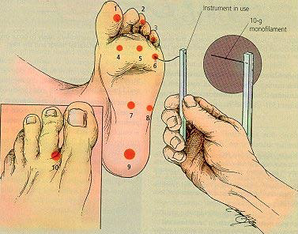
Sensory Monofilament Exam
Determine if can feel pressure when eyes are closed

Slide 19
Safe Mobility AND Fall Prevention: Non-Skid Socks vs Shoes
Proper Foot Wear
Stop Universal Use of Non-skid Socks
Criterial for Use of Non-Skid Socks
Use Shoes for Walking
You can’t put non-skid
Socks on a diabetic pts
with severe peripheral
Neuropathy!

Slide 20
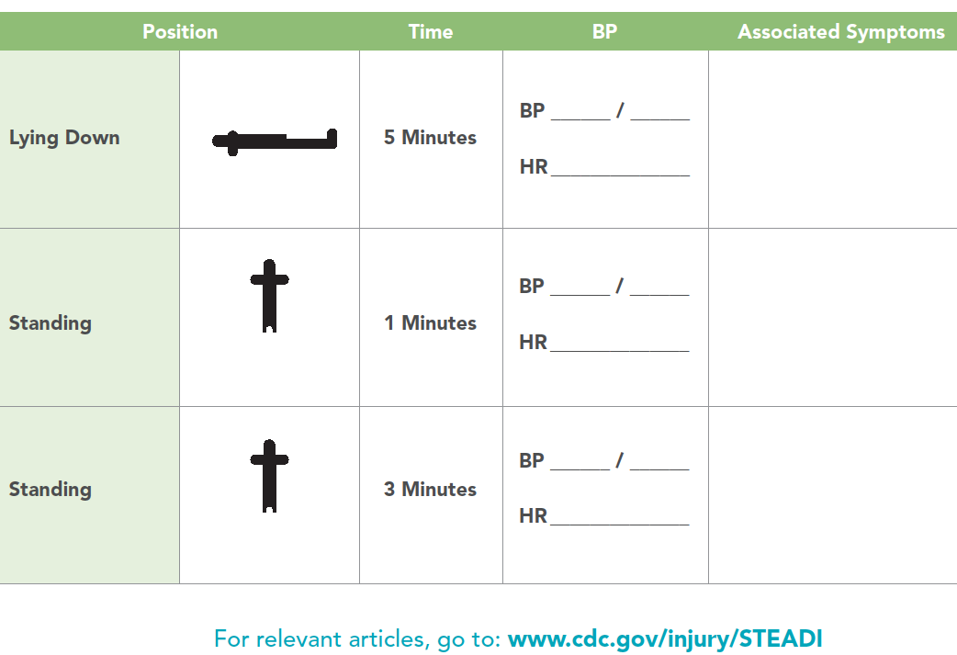
Notes:
Include this as an external link of the next steps page

Slide 21
Strategies to Transform Practice
Align practice redesign and innovations with national patient safety priorities:
Reduce Harm: Workforce Injury, Patient Fall Injuries
Create Safe Environments
Patient Engagement

Slide 22
Facts – What We Know from the Evidence
Not All Falls are Equal
Universal Fall Prevention Bundles are not effective
Forced Immobility is causing harm
”Non-compliance” is overused
Bed Alarms cause more harm than good
Falls are not just a nursing issue
Staff are still getting injured

Slide 23
Safe Mobility: Reduces Workforce Injury
SMPH: More Time for Staff to Use Equipment for Increasing Bariatric Population (Galinsky, et al. 2021)
Adherence to Best Practice Recommendations (Sorenson, et al. 2018)
Notes:
Galinsky, Deter, et al (2021). Safe patient handling and mobilty for increasingly bariatric patient populations: Factors related to caregivers’ self-reported pain and injury. Applied Ergonomics, 91, February 2021, 103300
https://www.sciencedirect.com/science/article/abs/pii/S0003687020302489
Sorenson, G., Sparer, E., et al. (2018). Measuring best practices for workplace safety, health and wellbeing: The Workplace Integrated Safety and Health Assessment. J Occupational Environ Med, 60(5): 430-439.
https://www.ncbi.nlm.nih.gov/pmc/articles/PMC5943154/

Slide 24
Staff Safety Perspective
Staff are getting hurt protecting patients from being injured during a fall occurring while transferring or ambulating
Staff safety will improve if we can prevent patients from falling
Staff Safety = Patient Safety

Slide 25
Gait Belts
Venema, D.,M. Skinner, A.M., Nailon, R., Conley, D., High, R., & Jones, K.J. (2019). Patient and system factors associated with unassisted and injurious falls in hospitals: An observational study. BMC Geriatrics, 19: 348. Available here

Slide 26
Fall Injury Interventions
Floor Mat
Hip Protectors
Helmets
Low Beds
Eliminate Sharp Edges
Assisted Fall
Gait Belts

Slide 27
Falls Committee Includes SPH
SPH facility champion attends regular Falls Committee mtgs.
Falls Committee owns:
Pre-Mobility Assessment (OH, PN)
Audits for:
Falls interventions
Use of equipment for Total Assist patients

Slide 28
Rely on Small Tests of Change: Planned Change Theory
Plan-Do-Check-Act (PDCA)
Focus on Assisted Falls and connection to Patient Handling in other departments during ambulation and transfers
Revise patient mobility assessment
Implement electronic assessment
Develop new Work Standards

Slide 29
Your Time to Share
What Topics Are Your Interested in Implementing?
What Steps Have Your Taken Since Our Webinar?
What Questions Do You Have?

Slide 30
Other Questions and Comments
How Else Can I Help You?

Slide 31
Our Webinar Schedule
Webinar 1: May 3. Enhancing Capacity: Reengineering Fall and Fall Injury Programs: Infrastructure, Capacity and Sustainability,
Coaching Session: May 17, Open Forum, Discussion
Webinar 2: June 7. Redesigning Post Fall Management
Coaching Session: June 21, Open Forum, Discussion
Webinar 3: July 5. Best Practices to reduce Falls Associated with Toileting
Coaching Session: July 19, Open Forum, Discussion

Slide 32
Our Webinar Schedule (con’t)
Webinar 4: Aug. 2. Safe Mobility is Fall Prevention
Coaching Session: Aug. 16, Open Forum, Discussion
Webinar 5: Sept. 6. Population-Specific Fall and Fall-injury Prevention
Coaching Session: Sept. 20, Open Forum, Discussion
Webinar 6: Oct. 4. Reducing Fall-related Injuries: Protective Interventions, Evidence and Application
Closing Coaching Session: Oct. 18 Open Forum, Discussion
Thank you!

Slide 33
Thank You for Attending Today’s Event
We value your input!
Please complete the brief survey after exiting event.

Slide 34
Next Steps
Join us for our next Learning series call: September 6, 2023, 2-3 pm EST
Falls series recording and slides: https://qi.ipro.org/2023/04/19/fall-and-injury-prevention-a-6-part-webinar-series/

Slide 35
IPRO HQIC & Speaker Contact Information
Rebecca Van Vorst MSPH CPHQ
Senior Director Quality Improvement
IPRO HQIC Project Manager
rvanvorst@ipro.org
CarlaLisa Rovere-Kistner, LCSW, CCM, CPHQ
Quality Improvement Specialist
IPRO
crkistner@ipro.org
Melanie Ronda, MSN, RN
Director, Health Care Quality Improvement
IPRO QIN-QIO
Nursing Home Lead, NY, NJ, Ohio
Infection Prevention Specialist
mronda@ipro.org
Amy Stackman, RN
Quality Improvement Specialist
IPRO QIN-QIO
astackman@ipro.org

