Slide 1
Falls: The Series
May-October 2023
Redesigning Post Fall Management
Coaching Session 2 – June 21, 2023
This material was prepared by the IPRO NQIIC, a Network of Quality Improvement and Innovation Contractor, under contract with the Centers for Medicare & Medicaid Services (CMS), an agency of the U.S. Department of Health and Human Services (HHS). Views expressed in this material do not necessarily reflect the official views or policy of CMS or HHS, and any reference to a specific product or entity herein does not constitute endorsement of that product or entity by CMS or HHS. Publication # IPRO-HQIC-Tsk56-23-317

Slide 2
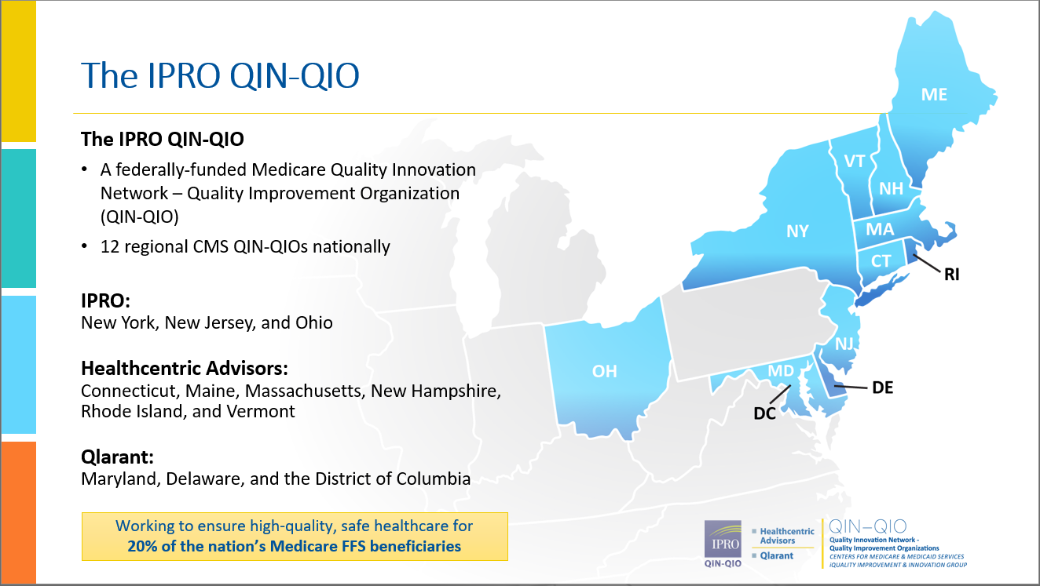
The IPRO QIN-QIO
The IPRO QIN-QIO
A federally-funded Medicare Quality Innovation Network – Quality Improvement Organization
(QIN-QIO)
12 regional CMS QIN-QIOs nationally
IPRO:
New York, New Jersey, and Ohio
Healthcentric Advisors:
Connecticut, Maine, Massachusetts, New Hampshire, Rhode Island, and Vermont
Qlarant:
Maryland, Delaware, and the District of Columbia
Working to ensure high-quality, safe healthcare for
20% of the nation’s Medicare FFS beneficiaries
Notes:
We are your QIN-QIO –
IPRO with Healthcentric Advisors and Qlarant. 3 Companies under the IPRO QIN-QIO. If you know one of us, you know IPRO!

Slide 3
Series Schedule: 2-3p.m. EST
Date | Session #/Topic
Wednesday, May 3 | 1. Enhancing Capacity – Reengineering Fall and Fall Injury Programs: Infrastructure, Capacity and Sustainability
Wednesday, June 7 | 2. Redesigning Post-Fall Management: Prevent Repeat Falls
Wednesday, July 5 | 3. Best Practices to Reduce Falls Associated with Toileting
Wednesday, August 2 | 4. Safe Mobility is Fall Prevention
Wednesday, September 6 | 5. Population-Specific Fall and Injury Prevention
Wednesday, October 4 | 6. Reducing Fall-Related Injuries: Protective Interventions’ Evidence, Application and Success

Slide 4
Your Participation Will:
Support organizational systems and teams to expand program infrastructure and capacity;
Help you redesign your fall prevention and injury reduction program;
Complement your evaluation program; and
Provide access to an online learning community to increase exchange of experiences, innovations, and best practice implementations.

Slide 5
Series Speaker
Patricia A. Quigley, PhD, APRN, CRRN, FAAN, FAANP, FARN
Nurse Consultant
Dr. Quigley is the President and Managing Member of Patricia A. Quigley, Nurse Consultant, LLC, which provides consultation to healthcare systems and patient safety organizations to advance patient safety programs and re-engineer integration of innovation at the point of care.
For more than 45 years, Dr. Quigley has practiced in the field of rehabilitation nursing. She is recognized for her leadership as a speaker, scholar, researcher, author, educator, and mentor.
Dr. Quigley’s contributions to patient safety, nursing, and rehabilitation are highly respected both nationally and internationally. She is known for her emphasis on clinical practice innovations designed to promote independence and safety for the elderly.
Dr. Quigley is currently a member of the National Quality Forum’s Prevention and Population Health Committee.

Slide 6
IPRO Coaching Webinars
Pat Quigley, PhD, MPH, APRN, CRRN, FAAN, FAANP, FARN
Nurse Consultant
E-Mail: pquigley1@tampabay.rr.com

Slide 7
Open Forum/Coaching Webinar Series Objectives
Provide an open forum for sharing, collaboration, and support.
Compose strategies to reduce barriers and enhance facilitators to short-term and long-term program implementation.
Address additional areas of fall program management as a community of learning.

Slide 8
Our Webinar Schedule
Webinar 1: May 3, Enhancing Capacity: Reengineering Fall and Fall Injury Programs: Infrastructure, Capacity and Sustainability,
  Coaching Session: May 17, Open Forum, Discussion
Webinar 2: June 7, Redesigning Post Fall Management
  Coaching Session: June 21, Open Forum, Discussion
Webinar 3: July 5, Best Practices to Reduce Falls Associated with Toileting
  Coaching Session: July 19, Open Forum, Discussion

Slide 9
Our Webinar Schedule (cont.)
Webinar 4: Aug. 2, Safe Mobility is Fall Prevention
  Coaching Session: Aug. 16, Open Forum, Discussion
Webinar 5: Sept. 6, Population-Specific Fall and Fall-injury Prevention
  Coaching Session: Sept, 20, Open Forum, Discussion
Webinar 6: Oct. 4, Reducing Fall-related Injuries: Protective Interventions, Evidence and Application
  Closing Coaching Session: Oct. 18, Open Forum, Discussion
Thank you!

Slide 10
A Refresher:
Post Fall Management
Patricia A. Quigley, PhD, MPH, APRN, CRRN,
FAAN, FAANP, FARN, Nurse Consultant
June 21, 2022
e-mail: pquigley1@tampabay.rr.com

Slide 11
Objectives
Examine post fall practices as key intervention to reduce repeat falls
Differentiate:
  Post Fall Huddles
  Post Fall Management
  Post Fall Documentation
  Incident Report

Slide 12
Burden
Falls affect between 700,000 - 1,000,000 patients each year (AHRQ, Patient Safety Network [PSNet], Patient Safety Primer: Falls. Updated Sept. 2019)
Fall Rates: 3-5/1000 patient days (AHRQ, PSNet, Sept 2019)
More than 1/3 of in-hospital falls result in injury (AHRQ, PSNet, 2019)
Ranked among the most reported incidents in hospitals and other facilities (AHRQ, PSNet, Sept 2019)
Falls can lead to severe injuries, hip fractures, and head trauma

Slide 13
Post Fall Practices
Post Fall Huddle
Post Fall Assessment
Patient/Resident/Family Education
Staff Education

Slide 14
Safety Huddles
Pre-Shift Huddles
Post-Fall Huddles
Conducted with the patient/resident where the fall occurred within 15 minutes of the fall
Post Fall Analysis
  What was different this time?
  When?
  How?
  Why?
  Prevention: Protective Action Steps to Redesign the Plan of Care

Slide 15
Post Fall Huddle (PFH): Essential Components
A brief staff gathering, interdisciplinary when possible, that immediately follows a fall event
Convenes within 15 minutes of the fall event
Clinician(s) responsible for patient/resident during fall event leads the PFH
Involves the patient/resident whenever possible in the environment where the patient/resident fell
Requires Group Think to discovery what happened
Utilizes discovery to determine the root cause/immediate cause of the fall: why the patient/resident fell
Guiding question to ask: What was different this time you were doing this activity, compared to all the other times you performed the same activity (and did not fall)?

Slide 16
Steps to the Post Fall Huddle
1. TL makes
announcement
2. Convene within 15
minutes with the patient/resident in the environment where the patient/resident fell
3. Conduct Analysis: determine root cause of fall, injury and Type of Fall
4. TL summarizes information gleaned from PFH and intervention(s) for prevention of repeat falls are decided by the huddle team
5. TL completes of the Post-Fall Huddle Form and processes the form according to medical center policy and procedure
6. Modifies the fall prevention plan of care to include interventions to prevent repeat fall
7. Communicate updated plan of care in patient/resident hand-off reports
8. Complete EMR Post-Fall Note

Slide 17
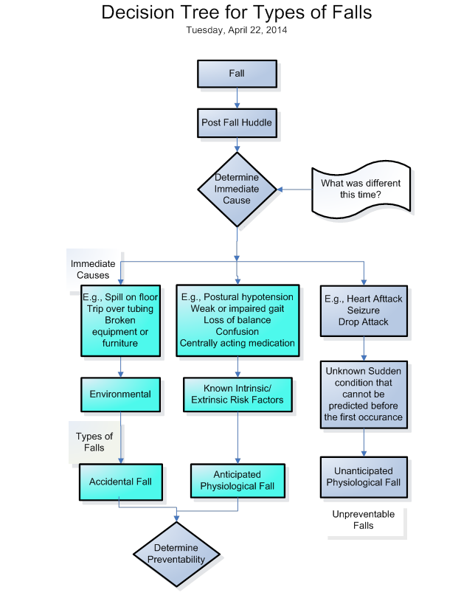
Decision Tree for Types of Falls

Slide 18
Determine Preventability
Step 1: Conduct the Post Fall Huddle.
Step 2: Determine the Immediate Cause of the Fall.
Step 3: Determine the Type of Fall.
Step 4: If Accidental and Anticipated Physiological Falls, determine Preventability:
Could the care provider (direct care provider) have anticipated this event with the information available at the time?
If the Answer is NO, the fall is not preventable.
If the answer is YES, the provider must ask another question: Were appropriate precautions taken to prevent this event?
Answer:
  No, Clearly or likely Preventable;
  Yes, Clearly or likely Unpreventable
Levinson, D. R., (2010, Nov). Adverse events in hospitals: National incidence among Medicare beneficiaries. DHHS. OEI-06-09-00090

Slide 19
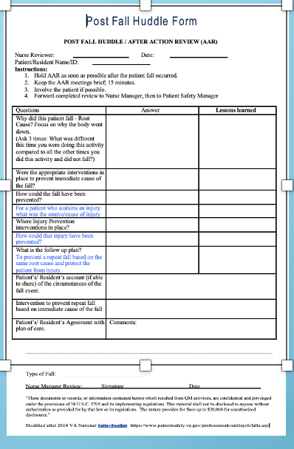
Post Fall Huddle Form
Don’t Morph This Form to Be Something Else

Slide 20
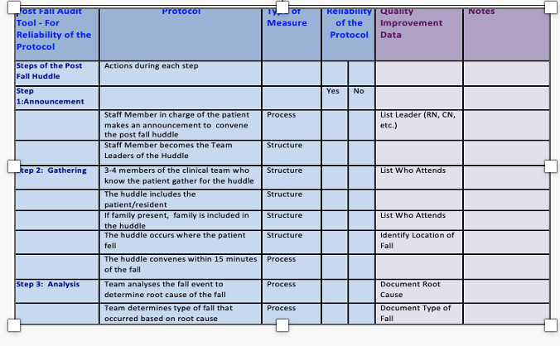
Let’s Take a Look
My Audit Tool

Slide 21
Outcomes of Post Fall Huddles
Specify Root Cause (proximal cause)
Specify Type of Fall
Identify actions to prevent reoccurrence
Changed Planned of Care
Patient/Resident (family) involved in learning about the fall occurrence
Prevent Repeat Fall
Reduce Repeat Fall Rate

Slide 22
Post Fall Huddle Resources
VA: Falls Toolkit
Post Fall Huddles
www.patientsafety.va.gov
AHRQ Falls Toolkit 2013

Slide 23
Outcomes of Post Fall Huddles
Specify Root Cause (proximal cause)
Specify Root Cause of Injury
Specify Type of Fall
Identify actions to prevent reoccurrence
Changed Planned of Care
Patient/Resident (family) involved in learning about the fall occurrence
Prevent Repeat Fall

Slide 24
Formative Measures
Structures:
  Who attends: Nursing and others – Count them
  Changed Plan of Care: Add actions to your run-chart: Annotated run chart; Capture interventions
  Processes:
    Timeliness of Post Fall Huddle (number of minutes)
    Timeliness of changing plan of care
    Time to implemented changed plan of care

Slide 25
Summative Outcome
Prevent Repeat Fall: Same Root Cause and Same Type of Fall
Reduce costs associated with falls and fall related injuries

Slide 26
Post Fall Assessment
Different than a Huddle!

Slide 27
Post Fall Assessment
In-depth Data Gathering
Circumstances of the Fall
Patient/Resident Presentation
Assessment of Patient/Resident Condition

Slide 28
Comprehensive Post-Fall Assessment
Includes:
General information about the fall
Subjective & objective falls documentation
Patient/Resident Assessment – vital signs; visible signs of injury (type & pain scores); glucometer (if diabetic or facility policy); Glasgow Scale (if suspected brain injury) and Morse Falls scale
Interventions based on Fall Risk Scale/Morse falls scale
Facility personnel and family notification

Slide 29
Teaching: After a Fall
Reframe patient/resident education curricula to include "what happens after a fall".
What can we learn from this event?
How can we work together to prevent this again?

Slide 30
Staff Education
Universal Fall Prevention
Individualized Fall Prevention
Injury Reduction Strategies
Root Cause Trends of Falls
Interventions for Improvement
Impact of Changes in Practices

Slide 31
My Unit Story Board
RC

Slide 32
Learn from Falls: Change Your Conversation
Talk About and Trend Root Causes
Monitor Interventions for Mitigation/Elimination of Root Causes
Align Interventions to Type of Falls
Precision In Program Evaluation: Reduction
  Accidental Falls
  Anticipated Physiological Falls
  Unanticipated Physiological Falls

Slide 33
What Did You Learn?
Compare your PFH Process with what was presented.
Compare your Post Fall Management Process with what was presented.
Review the PFH Audit Tool for your use.

Slide 34
Your Turn to Share
What Steps Have You Taken Since Our Webinar?

Slide 35
Please Share
What Questions Do You Have?

Slide 36
Open Forum
How Else Can I Help You?

Slide 37
Our Upcoming Webinar Schedule
Webinar 3: July 5. Best Practices to reduce Falls Associated with Toileting
  Coaching Session: July 19, Open Forum, Discussion

Slide 38
Thank you!
You Can Always Reach Me!
Patricia Quigley, PhD, MPH, ARNP, CRRN, FAAN, FAANP, Nurse Consultant
pquigley1@tampabay.rr.com

Slide 39
Next Steps
Join us for our next Learning call: July 5,2023 2-3p.m. EST
Best Practices to Reduce Falls Associated with Toileting
Falls series recording and slides: https://qi.ipro.org/2023/04/19/fall-and-injury-prevention-a-6-part-webinar-series/

Slide 40
Thank You for Attending Today’s Event
We value your input!
Please complete the brief survey after exiting event.

Slide 41
IPRO HQIC & Speaker Contact Information
Rebecca Van Vorst MSPH CPHQ
Senior Director Quality Improvement
IPRO HQIC Project Manager
rvanvorst@ipro.org
CarlaLisa Rovere-Kistner, LCSW, CCM, CPHQ
Quality Improvement Specialist
IPRO
crkistner@ipro.org
Melanie Ronda, MSN, RN
Director, Health Care Quality Improvement
IPRO QIN-QIO
Nursing Home Lead, NY, NJ, Ohio
Infection Prevention Specialist
mronda@ipro.org
Amy Stackman, RN
Quality Improvement Specialist
IPRO QIN-QIO
astackman@ipro.org

