Slide 1
Staying Up-to-Date With Your Vaccinations
WAVE: What About Vaccines? Every Time
This material was prepared by the IPRO QIN-QIO, a Quality Innovation Network-Quality Improvement Organization, under contract with the Centers for Medicare & Medicaid Services (CMS), an agency of the U.S. Department of Health and Human Services (HHS). Views expressed in this material do not necessarily reflect the official views or policy of CMS or HHS, and any reference to a specific product or entity herein does not constitute endorsement of that product or entity by CMS or HHS. 12SOW-IPRO-QIN-TA-AA-23-1141
Notes:
Today we are going to discuss the importance of staying up to date with recommended adult vaccines.

Slide 2
The IPRO QIN-QIO
The IPRO QIN-QIO
A federally-funded Medicare Quality Innovation Network – Quality Improvement Organization
(QIN-QIO)
12 regional CMS QIN-QIOs nationally
IPRO:
New York, New Jersey, and Ohio
Healthcentric Advisors:
Connecticut, Maine, Massachusetts, New Hampshire, Rhode Island, and Vermont
Qlarant:
Maryland, Delaware, and the District of Columbia
Working to ensure high-quality, safe healthcare for
20% of the nation’s Medicare FFS beneficiaries
Notes:
This educational session is brought to you by the IPRO QIN-QIO: a quality improvement organization that supports Medicare beneficiaries.

Slide 3

Why Should I Get Vaccinated?
Vaccines save lives
Vaccines are the best way to protect you and your loved ones from preventable disease
Vaccines can prevent serious illness and hospitalization
Vaccines are safe
COVID-19, influenza, and pneumococcal vaccines are some of the most important vaccines for adults
Other vaccines may be recommended by your provider
Notes:
Vaccines have saved lives for over 100 years, but serious disease is still a threat. Adults need to keep their vaccinations up to date because protection from vaccines can fade over time.
By getting vaccinated, you can protect yourself and avoid spreading preventable diseases to others in your family and community.
You are at risk for different diseases as an adult than you were as a child. Some vaccine-preventable diseases can have serious complications leading to hospitalization.
Vaccination is one of the most convenient and safest ways to prevent illness and protect your health.
It’s important to get a yearly flu shot and to stay up to date on your COVID-19 vaccine.
Depending on your age, health conditions, and lifestyle it is important to talk with your provider about which vaccines are right for you.

Slide 4
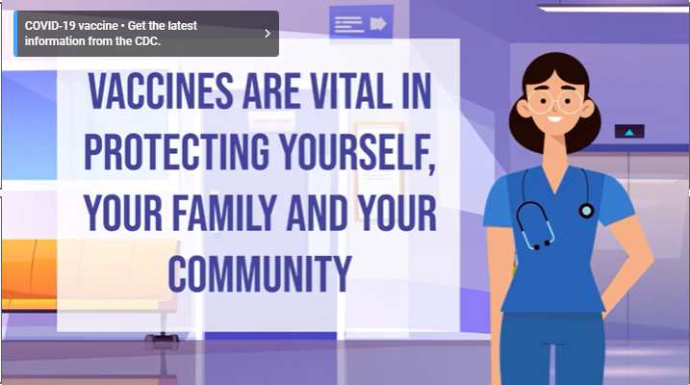
Vaccines are Important!
https://www.youtube.com/watch?v=aBIBsfrAnkI
Notes:
This short video was created by MCHCP (Missouri Consolidated Health Care Plan) on the importance of vaccines. (August 10, 2021). The health plan information at the end is specific for Missouri but the message regarding vaccines is important for all adults.
Play video

Slide 5

Let’s Focus on These Vaccines
Influenza (flu) vaccine
COVID-19 vaccine
Pneumococcal vaccine
Respiratory Syncytial Virus (RSV) vaccine
Notes:
Today we are going to focus on these four important vaccines.

Slide 6
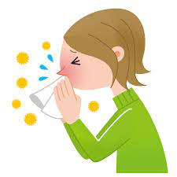
Influenza Vaccine
The flu is a contagious disease that can make you very sick
The flu can result in hospitalization and even death
The number one best way to avoid getting seriously sick from the flu is to get the annual flu shot
Notes:
Seasonal influenza (flu) is a respiratory virus that sickens millions of people every year in the United States.
The annual flu vaccine helps you avoid infection and reduces your chances of being hospitalized or dying if you do become infected.
The flu virus strain changes every year, so it is important to get an updated flu vaccine every year. Flu vaccine also protects you from serious complications like flu-related pneumonia and flu-related heart attack or stroke.

Slide 7
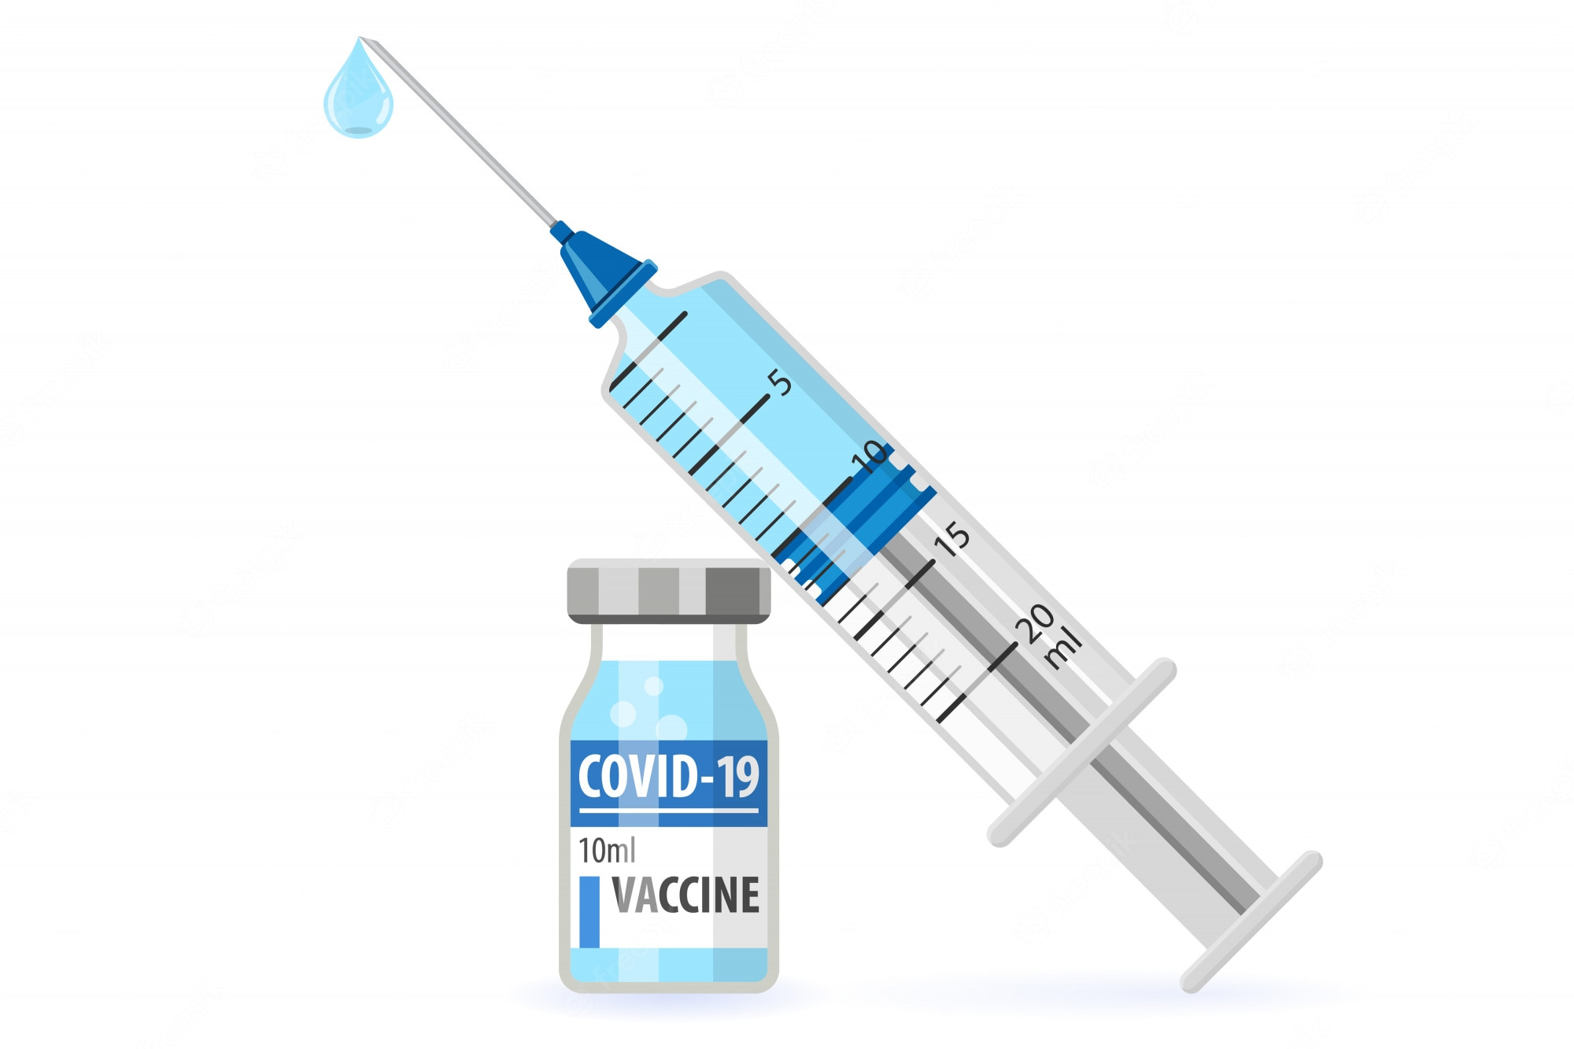
COVID-19 Vaccine
COVID-19 is a disease caused by the SARS-CoV-2 virus
It is highly contagious and can cause respiratory symptoms
It can result in serious illness and hospitalization
The updated COVID-19 vaccine is safe and effective
Stay up-to-date with the COVID-19 vaccine
Notes:
This disease originated in 2019 and has caused over 90 million illnesses and over 1 million deaths in the United States alone.
COVID-19 was the 3rd leading cause of death in 2020 and 2021 and the 4th leading cause of death in 2022.
Older adults and people with weakened immune systems are more likely to get severely ill
The COVID-19 vaccine is safe and can prevent serious illness, hospitalization, and even long-term effects of COVID-19.
It’s important to stay up-to-date with the COVID-19 vaccine.

Slide 8
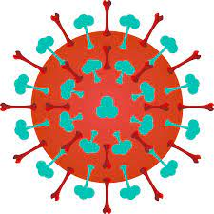
Why Get the COVID-19 vaccine?
Provides better protection against the Omicron strain
Omicron strain continues to circulate
Boosts your immune response to the original COVID-19 virus
Prevents serious outcomes from COVID-19 infection:
  Milder infection
  Less hospitalization
More vaccinated people means less circulating virus
Notes:
The vaccine protects a person against the latest COVID-19 strains that are currently circulating.
When people gather indoors with less social distancing and less mask wearing, the number of COVID infections can increase.
The updated vaccine provides an excellent immune response to current strains of the virus increasing your protection
COVID-19 infection was the 3rd leading cause of death in 2020 and 2021. Receiving an updated vaccine can prevent serious complications from COVID-19 infection and less chance of being hospitalized.
The more people vaccinated means the virus has less chance of changing and spreading and decreases the number of COVID-19 infections in the community. This is known as “herd Immunity” and can protect everyone.

Slide 9

Pneumococcal [noo-muh-KOK-uhl] Disease
An infection caused by the bacteria “Streptococcus pneumoniae”
There are many types of pneumococcal infections
Infections can be serious and result in hospitalization
Certain risk factors and medical conditions can put people at increased risk for disease
Pneumococcal vaccines are safe and effective
Notes:
Pneumococcal disease is a name for any infection caused by the bacteria called Streptococcus pneumoniae
Pneumococcal infections can range from ear and sinus infections to more serious diseases like pneumonia and bloodstream infections
Most pneumococcal infections are mild, however some can progress to pneumonia or other complications and result in hospitalization and death
Anyone can get pneumococcal disease but people with certain medical conditions like diabetes, heart disease, and asthma are at increased risk for the disease
Vaccines are the best way to prevent pneumococcal disease: even though anyone can get the disease older adults are at greatest risk of serious illness and death

Slide 10
Pneumococcal [noo-muh-KOK-uhl] Vaccination
Adults who have never received a pneumococcal vaccine should receive PCV 15* or PCV 20 if they:
  Are 65 years and older OR
  Are 19 through 64 years old and have certain medical conditions or other risk factors
Talk with your provider to see which vaccine is right for you
  *If PCV15 is used it should be followed by a dose of PPSV23.
Notes:
There are two types of pneumococcal vaccines and these are the current recommendations for adults
It is important to talk with your doctor to see what your risk is and what vaccine is right for you

Slide 11
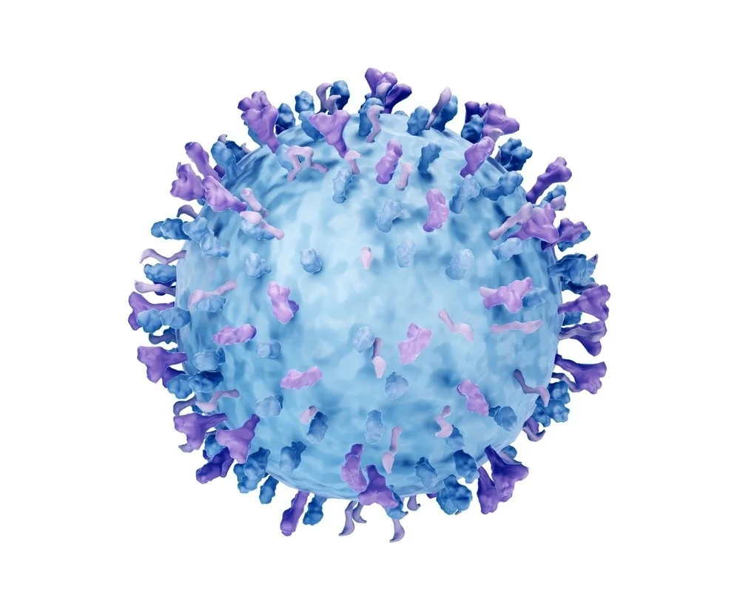
Respiratory Syncytial [sin-SISH-uhl] Virus (RSV)
RSV is a common respiratory virus
Usually causes mild, cold-like symptoms
RSV circulates during the fall and winter months
Can be serious especially for older adults
  60,000-160,000 hospitalizations
  6,000-10,00 death due to RSV infection
Adults at highest risk include:
  Older adults, especially those 65 and older
  Adults with chronic heart or lung disease
  Adults with weakened immune systems
Notes:
Respiratory syncytial (sin-SISH-uhl) virus, or RSV, is a common respiratory virus that usually causes mild, cold-like symptoms. Most people recover in a week or two, but RSV can be serious, especially for infants and older adults.
Most people who get an RSV infection will have mild illness and will recover in a week or two. Some people, however, are more likely to develop severe RSV infection and may need to be hospitalized. Examples of severe infections include bronchiolitis (an inflammation of the small airways in the lung) and pneumonia. RSV can also make chronic health problems worse.

Slide 12
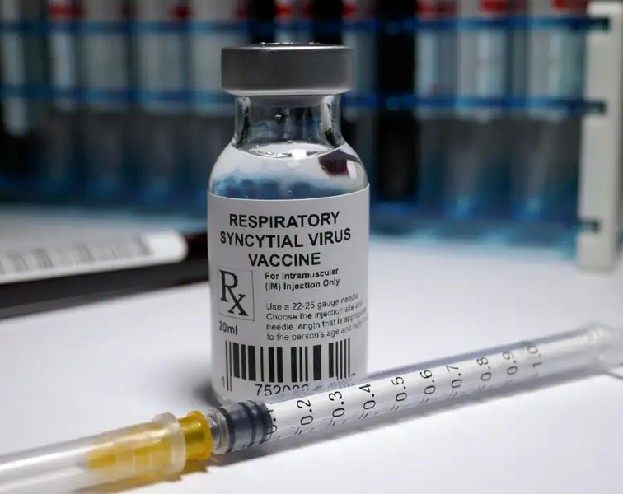
RSV Vaccine
The FDA has approved the first RSV vaccine for use in the U.S.
  For adults 60 years and older
Expected to be available Fall 2023
A single vaccine dose:
  Lowers risk of developing lower respiratory tract infection
  Lowers risk of developing severe RSV-associated lower respiratory tract infection
Notes:
In May the U.S. Food and Drug Administration approved Arexvy, the first respiratory syncytial virus (RSV) vaccine approved for use in the United States. Arexvy is approved for the prevention of lower respiratory tract disease caused by RSV in individuals 60 years of age and older.

Slide 13
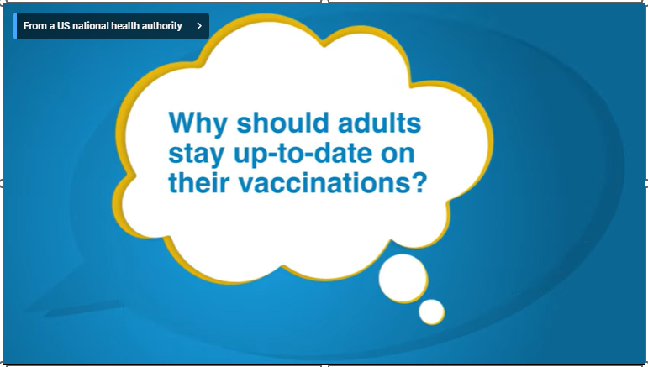
FDA weighs in on Adult Vaccinations
https://www.youtube.com/watch?v=dgXDbXphZDI
Notes:
Let’s take a look at this video to hear what the FDA has to say about staying up to date with adult vaccinations.

Slide 14
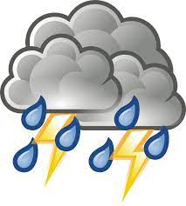
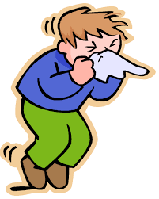
The Perfect Storm
Respiratory illness can occur at any time
Influenza and COVID-19 are predicted to worsen over the fall/winter seasons
Less infection control measures
Immune system protection decreased
Notes:
Respiratory illnesses like the flu, COVID-19, and even RSV (Respiratory syncytial virus) can circulate at anytime but especially in the winter season.
These illnesses are expected to worsen over the winter.
Prevention measures like masking and social distancing are no longer happening. People gathering indoors in large groups make it easier to spread the flu and COVID-19.
Because we have not seen much flu activity in the past few years as we have been practicing good pandemic prevention measures, our immune system will offer less protection to the flu virus this year.

Slide 15
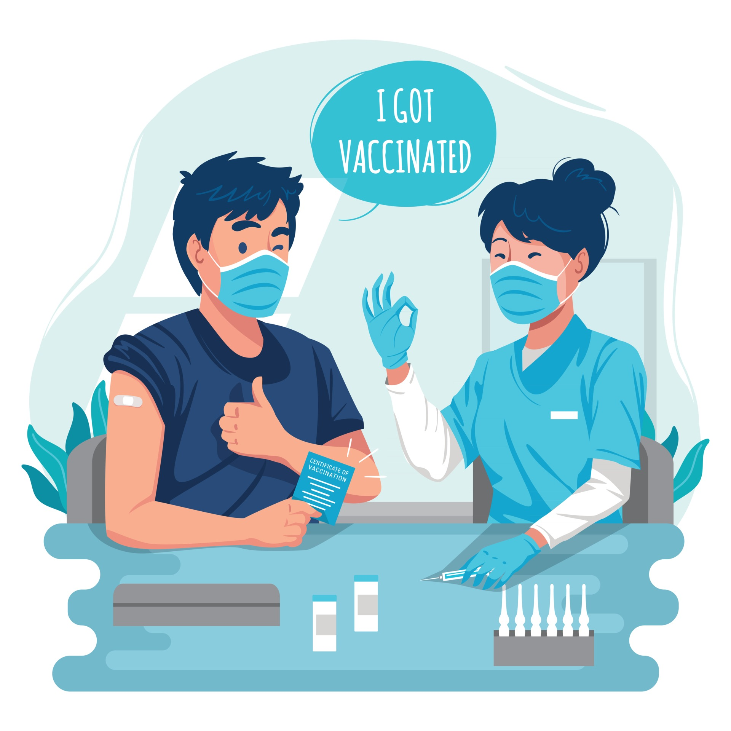
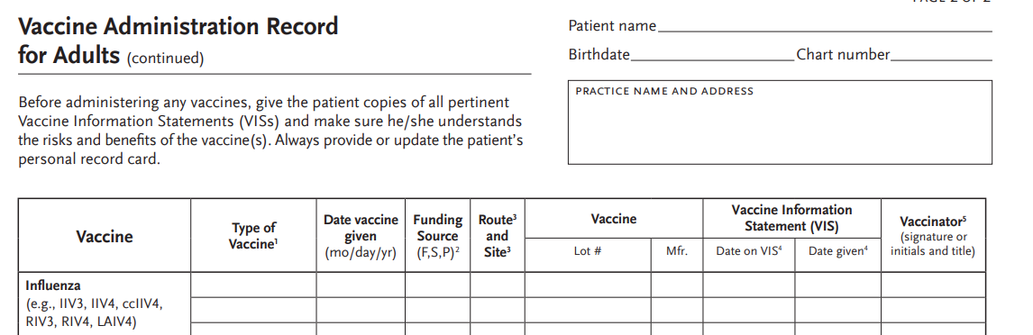
Keeping Your Vaccine Records Up to Date
It is important to keep a record of your vaccines
There are several places you can look to get your records
If you can’t find vaccine records talk to your provider
Always bring your immunization record form with you to your health visit every time
Photo source: Vecteezy.com
Notes:
Unfortunately, there is no national organization that maintains vaccination records, so it is important for you to find and/or keep a record of your vaccines.
Examples of places to look include asking your parents/caregivers if they have a copy, saved documents from your childhood, school vaccine records, previous employers, your provider or health clinic. Contact your state health department because some state’s have registries (immunization information services) that include adult vaccines.
If you can’t get records you may need to get some of the vaccines again. While this is not ideal, it is safe to repeat vaccines. You may also get blood tests to see if you are immune to certain vaccine-preventable diseases like chicken pox or measles.
Here is a link to a sample immunization record form through immunize.org.

Slide 16
Frequently Asked Questions
Are there bad side effects from all these vaccines?
  There are some side effects, including pain, redness, or swelling at the injection site, headache, fatigue, chills/fever, and muscle pain, BUT serious side effects are rare.
When should I receive the updated COVID-19 vaccine?
  Everyone 6 years and older should get 1 updated Pfizer-BioNTech or Moderna COVID-19 vaccine, regardless of whether they’ve received any original COVID-19 vaccines.
Is it safe to get the COVID-19 vaccine the same time as the flu vaccine?
  Yes! You can get other vaccines, including the flu vaccine at the same visit.
Notes:
Here are some frequently asked questions.

Slide 17
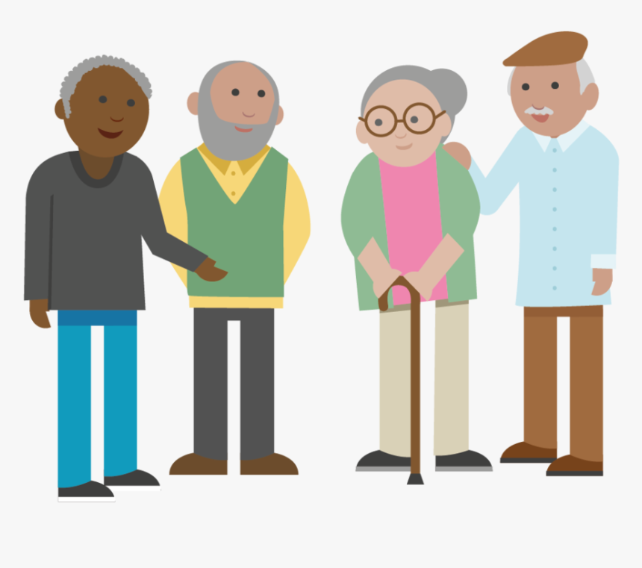
The Bottom Line
Vaccines are important any time of the year but especially during the fall/winter season
Concern for surges in the fall/winter season
Vaccines are safe and effective
It is safe to get the COVID-19 and flu vaccines at the same times
Vaccines offer added protection for you AND your loved ones
Staying up-to-date with all your vaccines keeps you healthy and avoids serious illness and hospitalization
Notes:
COVID-19 and flu cases are expected to climb during the cold season
As people gather indoors the risk of COVID-19 and flu spread increases due to close contact to other people and less use of protective measures like distancing and masking
Vaccines are safe and effective at protecting people from getting seriously ill, being hospitalized, and even dying. By getting vaccinated you not only protect yourself but your family and loved ones around you. It is safe and convenient to get the flu and COVID-19 vaccines at the same time
The flu shot offers good protection against serious illness. The COVID-19 vaccine offers added protection to people including those who have had COVID-19 infection, including protection against being hospitalized from a new infection, especially as variants continue to emerge
People are protected best when they stay up to date with all the recommended vaccines

Slide 18
Why should you and/or your loved one stay Up-to-Date with Recommended Vaccines?
Living in a nursing home increases your chances of becoming sick with respiratory illnesses:
  Age
  Comorbidities
  Communal living
  Inability to manage respiratory etiquette or secretions
Don’t forget to ask your family to be vaccinated or if you are the visitor to be vaccinated
https://www.cdc.gov/vaccines/schedules/hcp/schedule-app.html#download
Notes:
Nursing home residents have contributing factors that make them more at risk of getting very sick and/or hospitalized from respiratory illnesses. Their risks include advancing age and comorbidities, for example: many residents have respiratory compromise. When a person whose lungs do not work properly gets sick with a respiratory virus, they are much more likely to get very sick or need hospitalization.
Living in a congregate setting, such as a nursing home, where people gather in small spaces to have activities and to eat meals, increases the risk of spreading germs.
Please remember many residents do not have the ability to properly manage respiratory etiquette, such as coughing in their sleeves or using a tissue and throwing it away, then cleaning their hands.
You have learned during the presentation about recommended adult vaccines and now you know why it is so important to vaccinate your loved one who is living in a nursing home. Please remember how important it is for visitors to be vaccinated against infectious illness as well, such as influenza and COVID-19 to prevent introducing these illnesses to residents in the nursing home.

Slide 19
Resources
Benefits of Getting A COVID-19 Vaccine | CDC
Five Reasons It Is Important for Adults to Get Vaccinated
Flu and People 65 Years and Older
Immunize.org
Safety of COVID-19 Vaccines | CDC
Vaccines.gov
Notes:
Here are some resources for additional information.

Slide 20
Learn More & Stay Connected
https://qi.ipro.org/
This material was prepared by the IPRO QIN-QIO, a Quality Innovation Network-Quality Improvement Organization, under contract with the Centers for Medicare & Medicaid Services (CMS), an agency of the U.S. Department of Health and Human Services (HHS). Views expressed in this material do not necessarily reflect the official views or policy of CMS or HHS, and any reference to a specific product or entity herein does not constitute endorsement of that product or entity by CMS or HHS. 12SOW-IPRO-QIN-TA-AA-23-1141
Notes:
Thank you!

